Slide 1
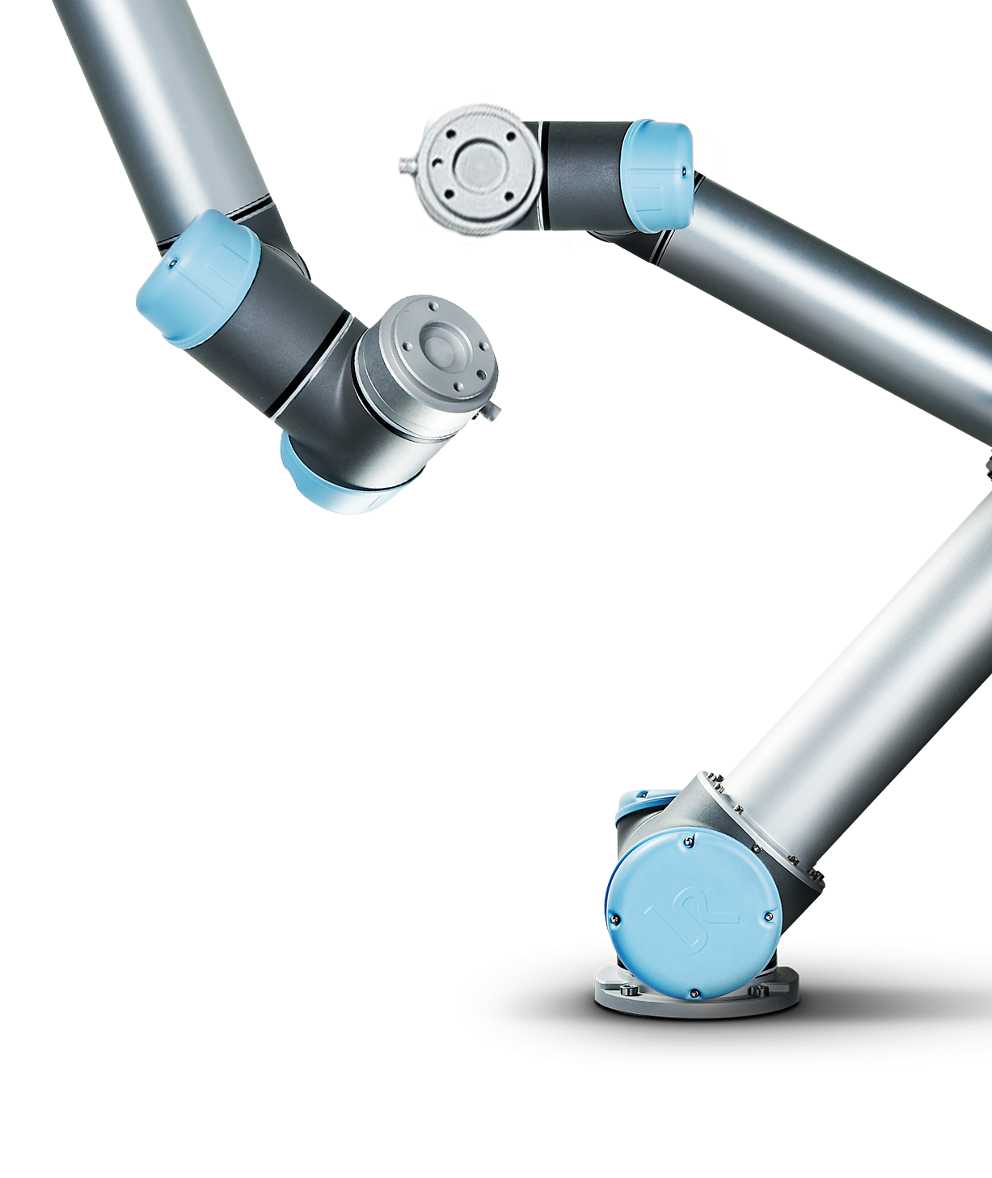
欢迎参加核心培训课程
这是包括优傲机器人基本理论和操作技巧的
技术培训课程

Slide 2
你的培训讲师
姓名：
职务：
Notes:
Present yourself, background, place in company

Slide 3

培训模块
1
拾取和放置应用
7
灵活部署
2
优化的拾取和放置应用
2
8
用力反馈功能拆垛
3
程序流程
3
9
简单启动
4
堆垛码垛
10
在线资源
5
操作者选择工艺应用
11
附录
6
安全设置
12
考试
Notes:
Overview of modules covered in Core Training
Inform participants that a written training will end with 30 min. written examination.

Slide 4

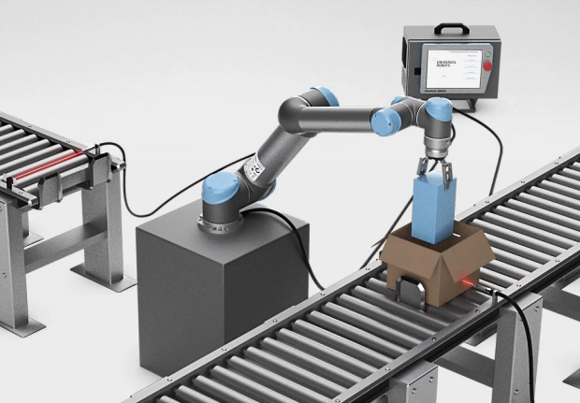


1
模块1：拾取和放置应用
培训师
开机并且演示移动选项卡
如何连接I/O信号
你的任务
用移动选项卡熟悉你自己的机器人
建立拾取和放置应用程序
（基于已经完成在线培训）
成功标准
拾取和放置程序可以运行，没有任何错误
Notes:
Intro: provide the learners with an overview of module 1
Explain what you will be telling them and what they are supposed to use this information for
Introduce the task and the related success criteria

Slide 5
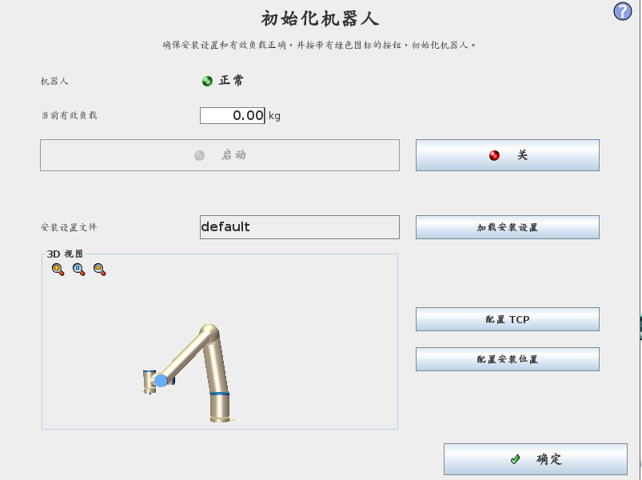
1
初始化机器人
机器人状态
初始化机器人
检查负载设置
点“开”：上电
点“启动”：释放刹车
反驱动模式
当靠近碰撞区域，用反驱动模式拉机器人手臂到安全位置
State | Power | Brakes
 | OFF | Engaged
 | ON | Engaged
 | ON | Released
Notes:
Initialize robot is where the robot can be initialized = mechanical brakes are released
Payload:
Payload specifies the weight of end-of-arm tooling.
It will automatically use the value defined in the Intallation, but can manually be changed if another or no tool is mounted.
In case the payload is defined incorrect and brakes are released, the robot will make a security stop and turn off the power.
(payload value must differ significantly to generate a security stop)
Procedure for initializing:
1. Check payload settings correspond with weight of actual end-of-arm tool STATE: POWER OFF
2. Press ON to enable power for the joints STATE: IDLE
3. Press ON again to release the mechanical brakes STATE: NORMAL
PERFORM LIVE DEMO
If robot is close to collision, the BACKDRIVE function can be used to move robot arm to safe position before initializing.
Backdrive mode:
Press ON to enable power for the joints.
Do NOT release the brakes.
2. Press and hold Freedrive» status will change to BACKDRIVE
3. Pull joint away from collision area » brake is released for only this joint as long as freedrive is pressed.
PERFORM LIVE DEMO of BACKDRIVE MODE

Slide 6
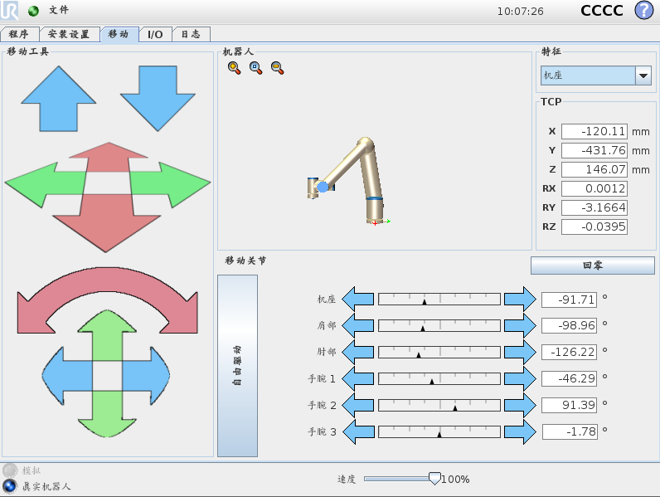
1
移动机器人
示教
单轴运动
工具姿态改变
最小/最大限制
显示角度值
线性移动
当示教XYZ，工具姿态固定
与选择坐标系相关
视角
基座
工具
自由驱动功能
用示教器的自由驱动按钮
用屏幕上自由驱动按钮
Notes:
Explain the different options of jogging the robot:
1. Move one joint individually
2. Move in cartesian (linear) space
3. Move by freedrive function
PERFORM LIVE DEMO
Min/max limits are displayed visually as well as values in degrees
Describe how the robot can be moved in cartesian space relative to a selected feature.
Default features:
Base
Tool
View (= similar to Base, but can be rotated when rotating the picture of the robot)
User defined features can be created in Installation-tab (will be covered in CB3 Advanced Training)
The POSE-editor can be accessed by pressing one of the numeric values on right side of screen > to be demonstrated later in training session

Slide 7
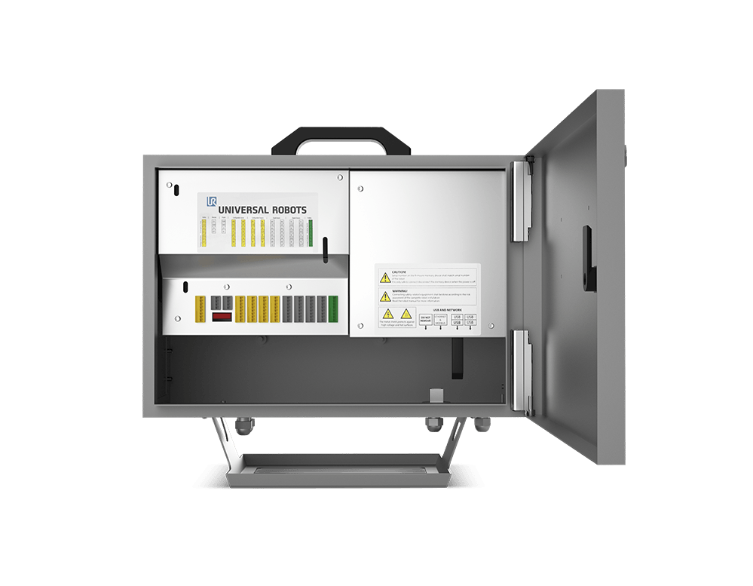
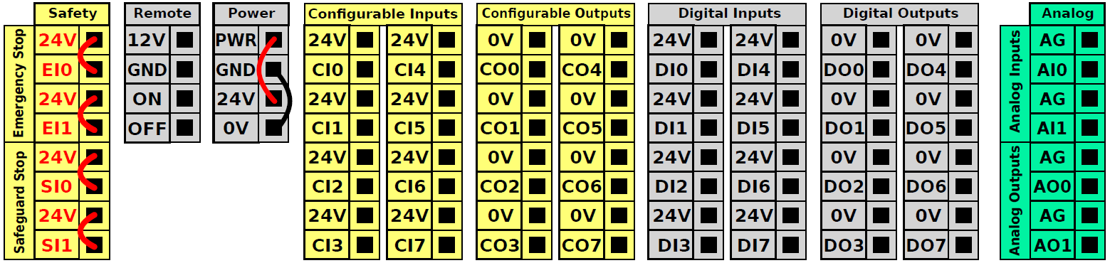
1
如何连接I/O信号
安全控制板 （SCB）
安全
紧急停止
安全停止
远程
Power on/off
电源
2A 内部 PSU
外部 PSU
可配置信号
8 输入
8 输出
24V DC, PNP
数字信号
8 输入
8 输出
24V DC, PNP
模拟信号
2 输入
2 输出
0-10V DC
4-20 mA
请查阅《用户手册》第4章 电气接口，最大负荷2A
Notes:
Schematic drawings
User interface on Safety Control Board (SCB)
Open User Manual and go through Chapter 4. Electrical Interface

Slide 8
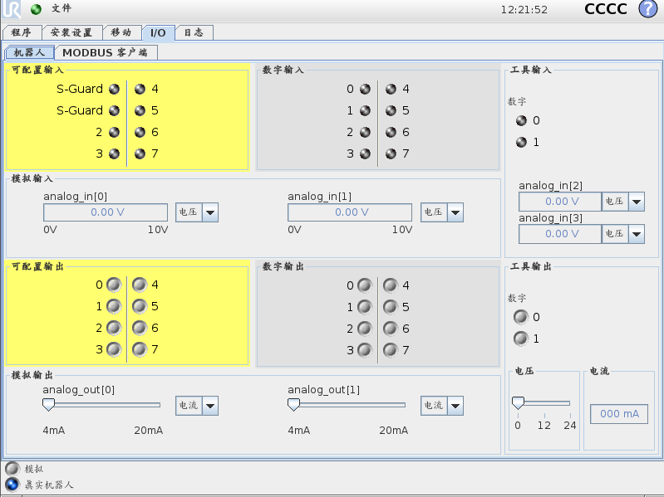
1
I/O选项卡
目的
和外部设备通讯
硬件接线到
控制箱
工具端接头
信号资源
控制箱
16 DI
16 DO
2 AI
2 AO
工具端接头
2 DI
2DO
2AI
Notes:
Signal handling
A robot program consists of movements and some interaction with external devices.
Digital and analog signals can be used for this interaction.

Slide 9


1
模块1：拾取和放置应用
讲师
开机并且演示移动选项卡
如何连接I/O信号
你的任务
用移动选项卡熟悉你自己的机器人
建立拾取和放置应用程序
（基于已经完成在线培训）
成功标准
拾取和放置程序可以运行，没有任何错误
Notes:
Instructor:
Explain to the learners how the work book and the reference guide are used
Work book: Contains the tasks the learners must complete during the training
Reference guide: Contains the procedural steps needed to complete the tasks in the work book
Introduce the first task and remind the learners that they are supposed to build a pick-and-place application similar to the one from the online training.
Introduce all the hardware used for the application (in relation to the ”hardware” from the elearning)
Inform the learners how much time they have to complete the assignment

Slide 10
1
模块1：拾取和放置应用
Success criteria
Pick-and-place application is able to run without any errors
跟踪：
问题/评论
Notes:
General feedback to the learners
Answer questions/comments

Slide 11
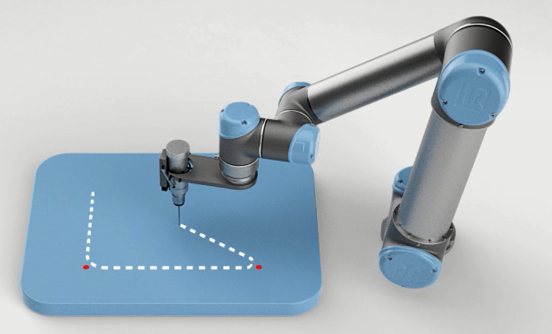
2
模块2：优化的拾取和放置应用
讲师：
如何优化：哪个工具是有效的？
你的任务：
通过减少节拍优化拾取和放置应用
平滑运动轨迹确保运动方式优化
微调位置
成功标准：
用有效工具确定应用优化的所有可能性
为应用设置目标节拍
Notes:
Intro: provide the learners with an overview of module 2
Explain what you will be telling them and what they are supposed to use this information for
Introduce the task and the related success criteria

Slide 12


2
优化工具：交融半径
交融半径允许机器人运动轨迹环绕路点运动，而不是直接通过此路段，这样机器人在路点位置不需要停止；这样保证运动轨迹平滑并且节省节拍。
MoveL (没有交融半径)
MoveL(带交融半径)
Notes:
THIS SLIDE CONTAINS MULTIPLE LAYERS, VIEW IT IN PRESENTATION MODE
Explain what a blend is and the purpose of using it (reduces cycle time and wear and tear on the robot)
Play the two videos (click them to play) to show the difference between no blend/blend
Give examples of when it is not advisable to use a blend radius (e.g. When picking up an object, need for precise trajectory)
In Polyscope, show how to add a blend to a waypoint (live demo)

Slide 13
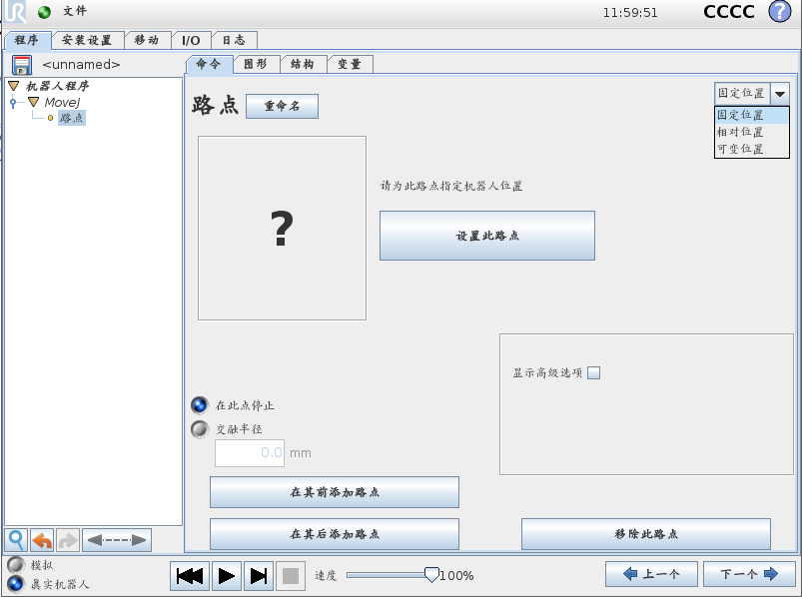
2
优化工具：交融半径
交融半径是在每一个路点中调整的
Notes:
Show how to adjust speed and acceleration of a move and all the waypoints within the move
PERFORM LIVE DEMO using one move containing several waypoints

Slide 14
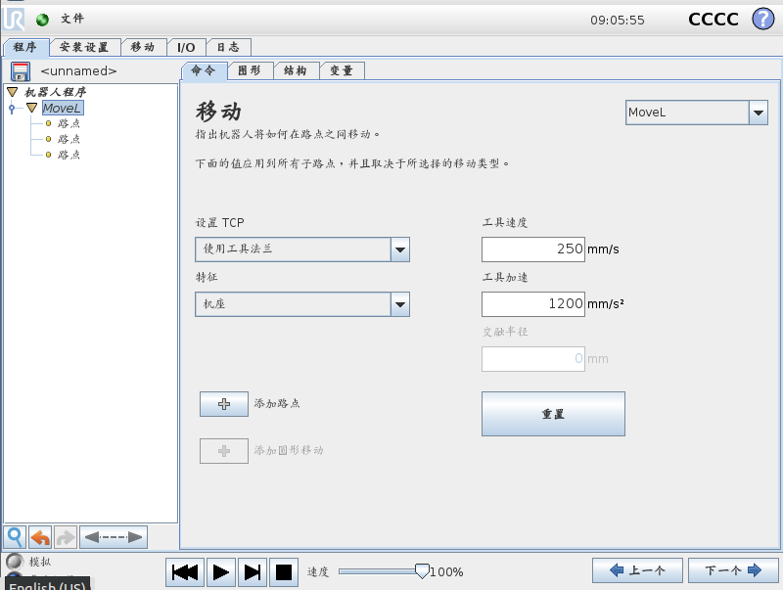
2
优化工具：运动速度和加速度
速度和加速度度设置适用于移动语句下的所有路点
Notes:
THIS SLIDE CONTAINS MULTIPLE LAYERS, VIEW IT IN PRESENTATION MODE
Show how to adjust speed and acceleration of a move and all the waypoints within the move
PERFORM LIVE DEMO using one move containing several waypoints

Slide 15
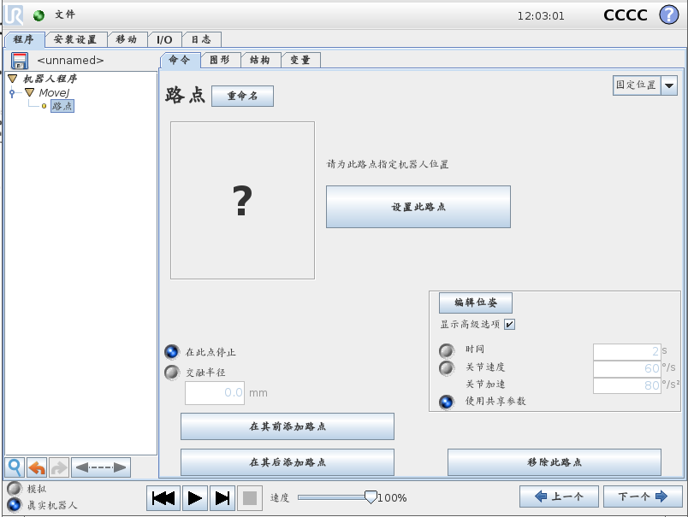
2
优化工具：单独路点的速度和加速度
独立设置
速度和加速度
时间
Notes:
Advanced options
In Advanced options speed and acceleration can be set individually for a waypoint.
Time can be set to specify how long it should take for robot to reach target position.
Unit is in seconds.
Joint angles and tool coordinates for the waypoint is displayed as well.
PERFORM LIVE DEMO show the difference when only one waypoint is adjusted

Slide 16
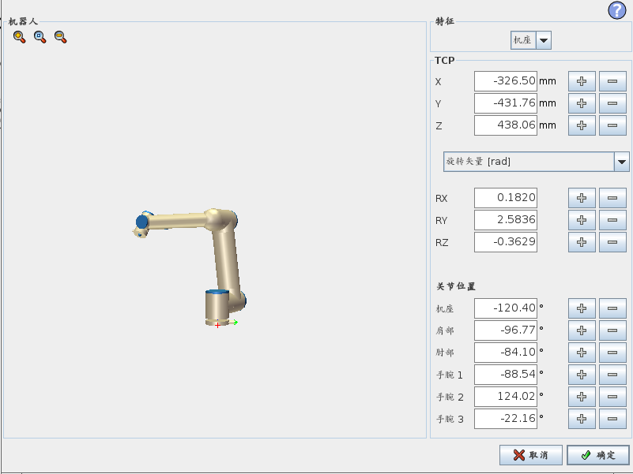
2
位姿编辑器
修改
绝对数值
加/减数值
关节位置
用度数表示的角度值
工具位置
笛卡尔坐标XYZ用mm.
旋转角度单位可定义
Notes:
Pose editor
Explain how to modify position using the pose editor
The absolute value of an axis or joint angle can be modified
By using the ”+” or ”-” button, a value can be added or subtracted to the absolute value
Upon modifying one or more values, press OK to move to the new position.
Units for defining angle of tool flange can be changed to
» Rotation vector [rad]
» Rotation vector [˚]
» RPY [rad]
» RPY [˚]
(RPY = Roll Pitch Yaw)
PERFORM LIVE DEMO

Slide 17
2
模块2：优化的拾取和放置应用
讲师：
如何优化：哪个工具是有效的？
你的任务：
通过减少节拍优化拾取和放置应用
平滑运动轨迹确保运动方式优化
微调位置
成功标准：
用有效工具确定应用优化的所有可能性
为应用设置目标节拍
Notes:
Introduce new task to participants – CONSULT WORKBOOK
- The learners have to optimize the pick-and-place application from the previous module by adding blends and increasing speed and acceleration of relevant moves/waypoints
- Inform the learners how much time they have to complete the assignment

Slide 18
2
模块2：拾取和放置优化
Success criteria
Identify all possibilities for optimizing the application using tools available
Set your own cycle time goal for the application
跟踪：
问题/评论
Notes:
General feedback to the learners
Answer questions/comments

Slide 19
3
模块3：程序流程
讲师
程序逻辑和 If…else 指令
使用变量
如何创建并且调用子程序
你的任务
为拾取和放置应用增加一个质量检测流程（每抓取第5个工件检测一次）
成功标准
每5个工件，用变量、if…else指令和调用子程序指令执行质量检测
Notes:
Provide the learners with an overview of module 3
Explain what theory you will go through and how they are supposed to use the commands and functionalities in the task
Introduce the task and the related success criteria

Slide 20

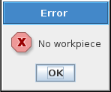
3
什么是程序逻辑？
程序逻辑决定了如何控制机器人程序流程，控制机器人程序流程的一个方法是用if…else指令
如果传感器1是True 运动到路点_1 否则弹出一个信息窗口
条件
条件是 True
条件是 false
Notes:
(remember to explain that ”True” is the same as ”HI/high”)

Slide 21
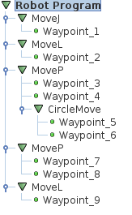
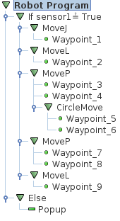
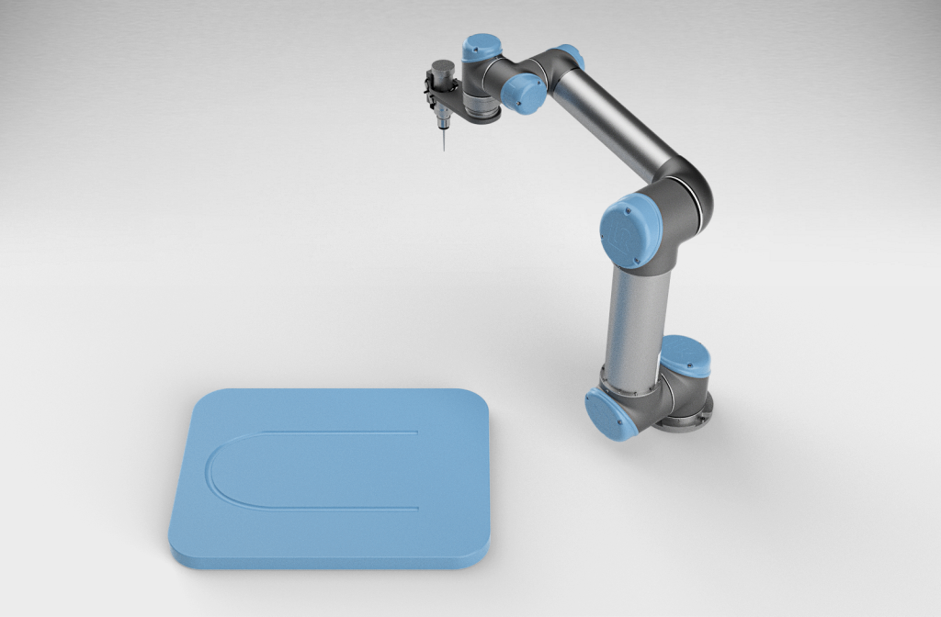



3
什么是程序逻辑？
初始程序
修改后的程序
Notes:
THIS SLIDE CONTAINS MULTIPLE LAYERS, VIEW IT IN PRESENTATION MODE
Use this modified example from elearning to explain what program logic is, and how an if…else command works
(remember to explain that ”True” is the same as ”HI/high”)
The program is no longer linear in the modified version, but will make a ”decision” at the if…else statement

Slide 22
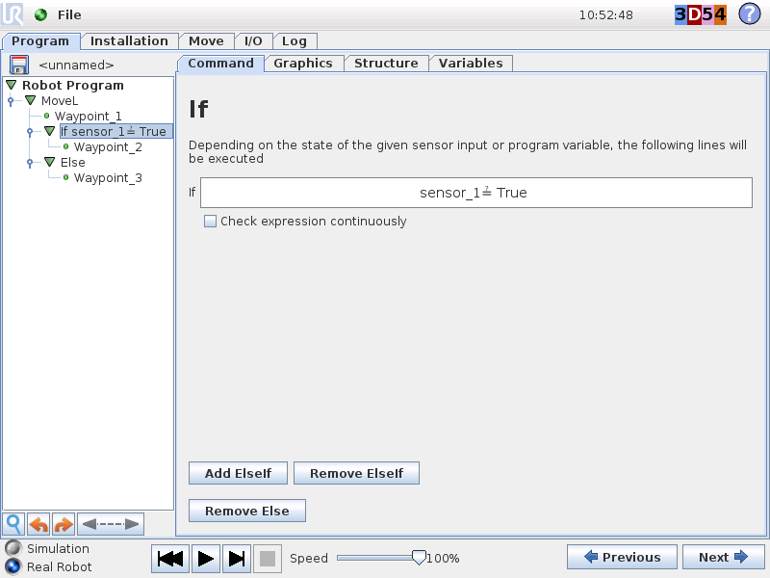
3
If ... else 指令
If
检验一个条件：
传感器状态
变量值
变量状态组合
If 条件 = True
执行下面的指令
If 条件 = false
跳到下一个条件的指令
Else条件是可选项
以上条件都不满足，执行下面的指令
Save sample program as if.urp
Notes:
If … else
Create sample program with 3 waypoints, but only move through Waypoint_2 if a digital input is True.
If the box ”Check expression continuously” is checked, it will behave as an interrupt and immediately exits the IF tree in case the expression is not valid
Modify sample and demonstrate.

Slide 23
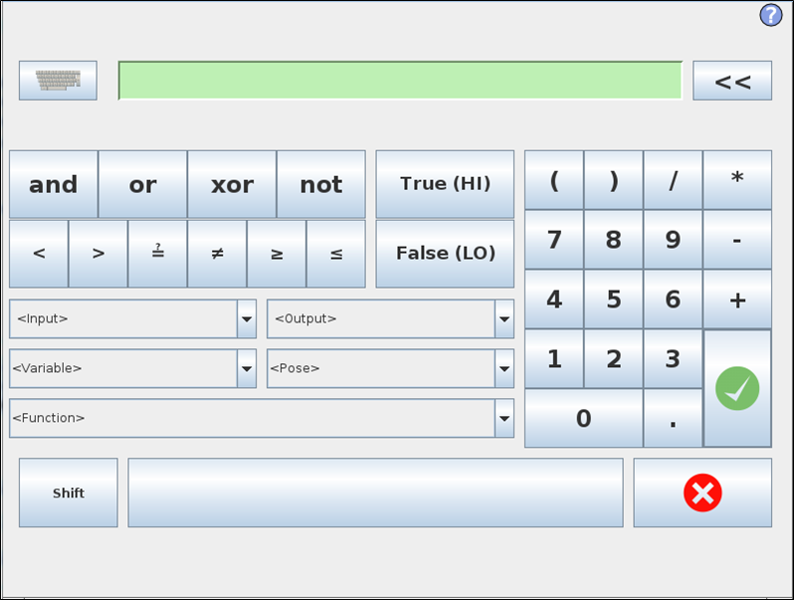
3
If ... else 指令
表达式编辑器
Notes:
Explain how the expression editor is used to specify the condition

Slide 24
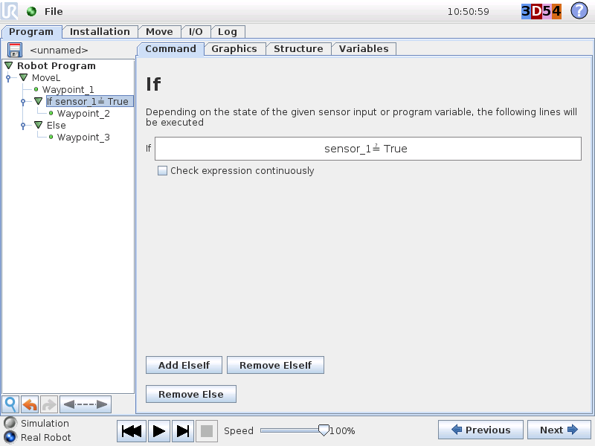
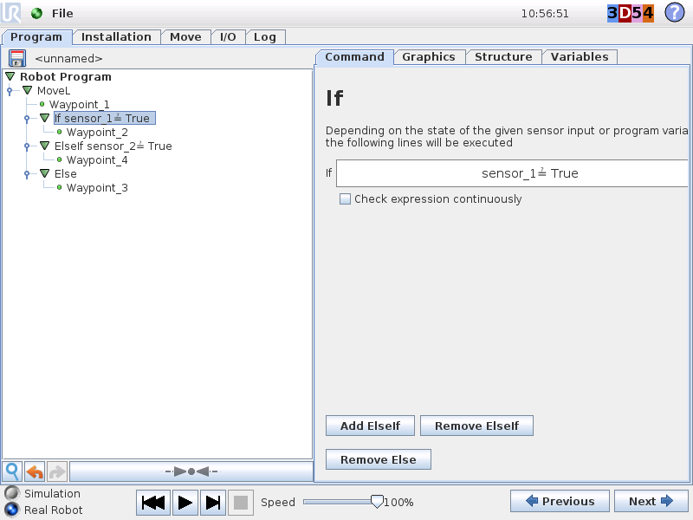
3
Elseif 指令
… elseif
检查新的条件
… else
当没有条件是True，定义做什么
Notes:
THIS SLIDE CONTAINS MULTIPLE LAYERS, VIEW IT IN PRESENTATION MODE
Elseif
Perform live demo of If...else +Elseif

Slide 25

3
什么是变量？
变量是一个存储单元（容器）
容器的内容能改变
变量可读可写
值能被重新写入
值能被读
变量可以和其他变化或传感器状态比较
变量可被用于
存储程序信息（时间或循环次数）
创造程序逻辑（可根据变量的值，机器人执行不同的功能）
Notes:
What is a variable?
A variable is a storage location (container).
Content (value) of the container can change.
Variables (in PolyScope) are read and write:
» Value can be overwritten by the program
» Value can be read and compared with another variable or sensor state

Slide 26
3
变量类型
当一个变量被创建时，它默认的名字是var_+一个数字，如var_1；用户可以重命名这个变量
变量类型 | 值 | 例子
布尔（boolean） | true/false | var_1:=False
整数（integer） | 32 bit，整数 | var_2:=25
浮点（floating point） | 实数（带小数点） | var_3:=11.23
字符串（string） | ASCII 码（文本） | var_4:=”hello_world”
位姿（pose） | 位姿变量 p[x,y,z,rx,ry,rz] | var_5:=p[0.1,-0.2,0.25,0,3.14,0]
数组（list） | 变量排列组合 | var_6:=[var_7,var_8,var_9]
位姿和列表变量在高级培训中会讲到
Notes:
Variable type
PolyScope can use a range of different variable types
» boolean
» integer
» floating point
» string
» pose
» list (contains a list of other variables)
EXAMPLE:
» A variable of boolean type can contain either True or False

Slide 27
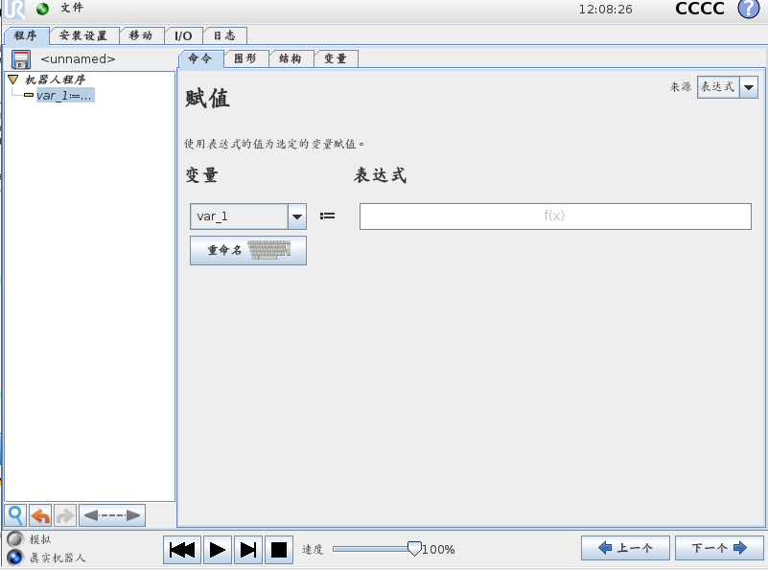
3
赋值指令
功能
定义变量名字
明确变量类型
给变量赋一个值
Notes:
THIS SLIDE CONTAINS MULTIPLE LAYERS, VIEW IT IN PRESENTATION MODE
Assignment
Demonstrate sample program where the variable switches between true and false every second – show on variables tab

Slide 28
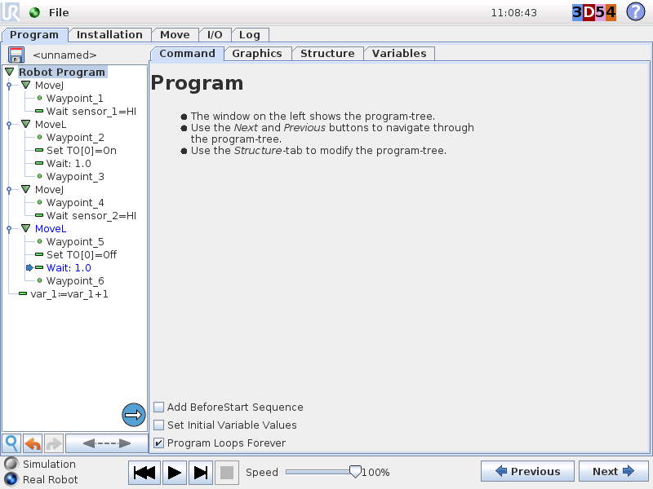
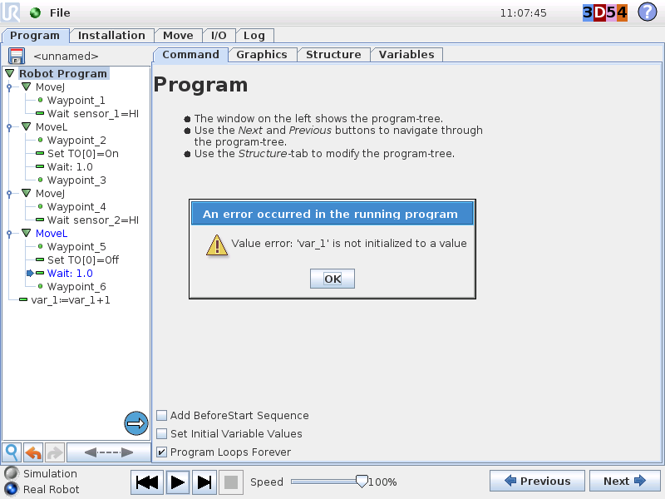
3
例子：变量作为循环计数器
每一个程序循环结束后，var_1的值加1
var_1=当前值 + 1
Notes:
Demonstrate how to declare variable as interger and use variable as counter.
Show what happens IF the variable is not initialized before examining the variable in the program > correct the program by adding initialization of variables in start of program.

Slide 29
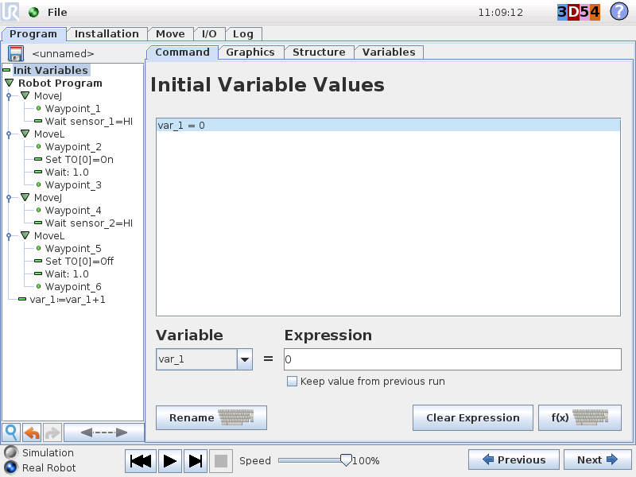
3
初始化变量值
初始化变量值
程序变量（局部变量）列表
预设一个固定值
Notes:
THIS SLIDE CONTAINS MULTIPLE LAYERS, VIEW IT IN PRESENTATION MODE
Init Variables
A sequence run only once before the start of the main program.
Purpose: to assign the needed starting values to the (program) variables used in the robot program
Init Variables section:
» All program variables are listed.
» Each variable can be preset to a fixed value.

Slide 30
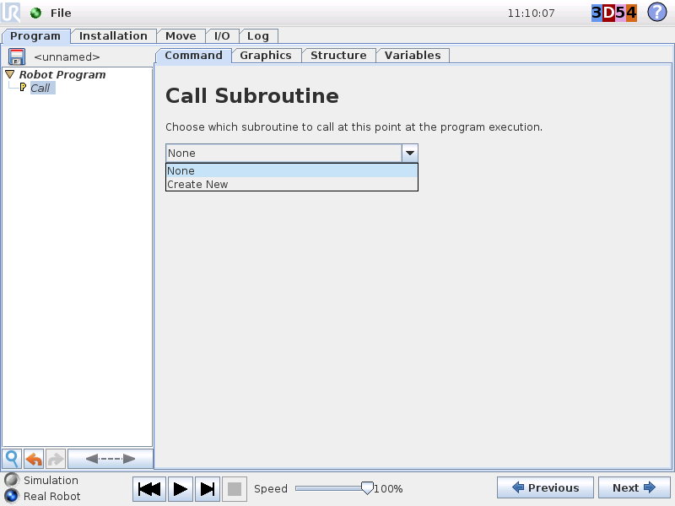
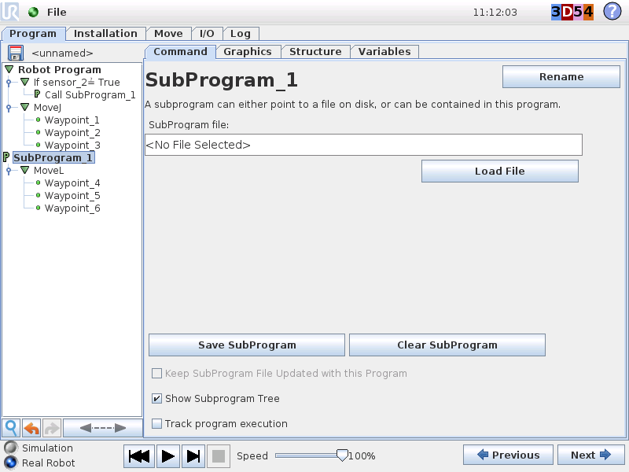
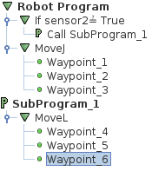
3
调用子程序指令
调用子程序
组织程序
把程序拆分成子程序
在多重程序中使用调用子程序功能
Notes:
THIS SLIDE CONTAINS MULTIPLE LAYERS, VIEW IT IN PRESENTATION MODE
SubProg
Using sub programs is a way of organizing the program structure.

Slide 31
3
模块3：程序流程
Instructor
Program logic and If…else commands
Using variables
How to create and call subprograms
你的任务
在拾取和放置程序中增加一个质量检测流程（每抓取5个工件检测一次）
成功标准
每5个工件，用变量、if…else和调用子程序指令完成质量检测流程
Notes:
Introduce new task to participants – CONSULT WORKBOOK
- The task is to add program logic to the pick-and-place application in order to introduce quality inspection in the application.
- Inform the learners how much time they have to complete the assignment

Slide 32
3
模块3：程序流程
Success criteria
For every 5 workpieces, perform quality inspection using variables, if...else commands and a subprogram
跟进
问题和评论
Notes:
Answer questions/comments

Slide 33
4
模块4：托盘
培训师
Polyscope向导
向导—托盘
你的任务
修改拾取和放置程序，输出到托盘上而不是传送带上
成功标准
用向导—托盘中的模式放置工件，并且提示操作员在放工件前确认新托盘
Notes:
Provide the learners with an overview of module 4
Explain what theory you will go through and how they are supposed to use the commands and functionalities in the task
Introduce the task and the related success criteria

Slide 34
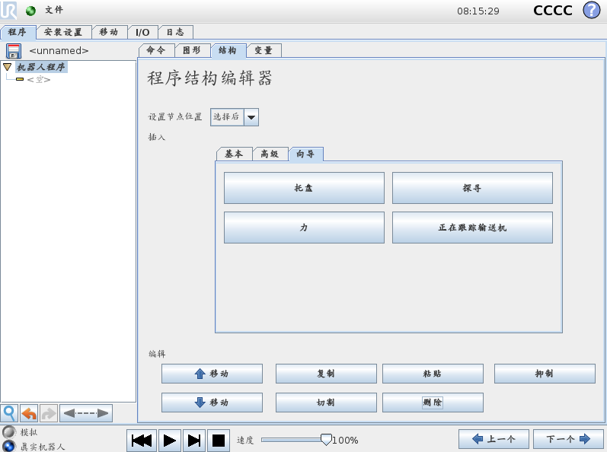
4
向导
托盘（Pallet）
码垛/拆垛
模式
探寻
搜索功能
力
力控功能
传送带跟踪
跟随传送带
运动

Slide 35
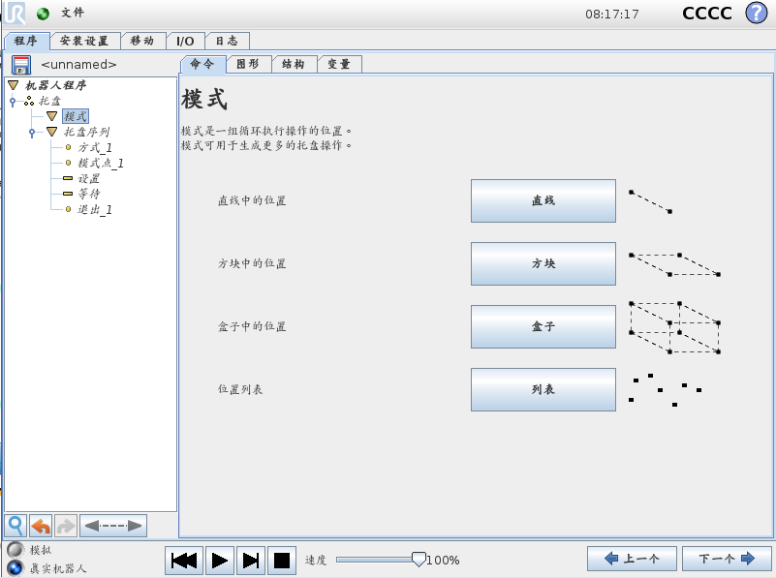
4
托盘向导
托盘
定义托盘码垛模式
模式
线性
方块
盒子
列表
按顺序码垛
不同模式下每一个点位置是做什么
Notes:
Pallet
Pallet wizard consist of:
» Pattern
- Line
- Square
- Box
- List
» PalletSequence
- what to do at each position in pattern
Next: Example of how to palletize in square

Slide 36
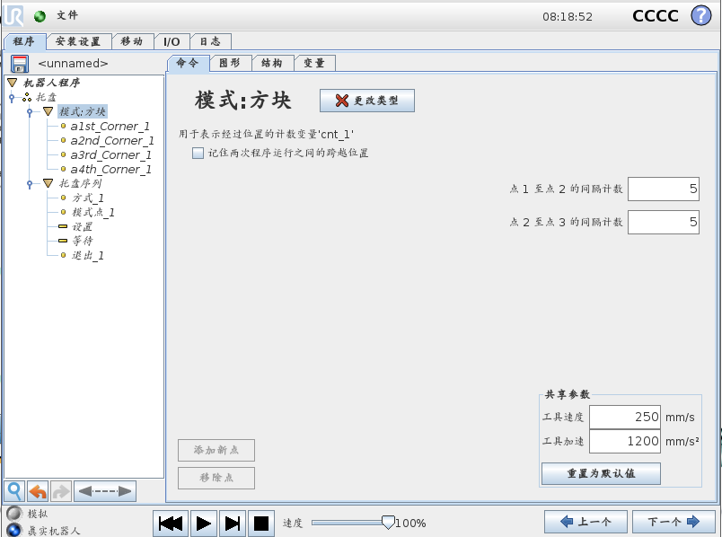
4
模式：方块
模式
设置模式：方块
设置目标点：
点1和点2
点2和点3
示教4个角目标点
Pattern
a2nd
set count
a3rd
set count
a1st
a4th
Notes:
Pattern: Square
1. Set pattern type: Square
2. Set amount of objects in two directions
3. Teach the 4 corners

Slide 37
4
托盘顺序
PalletSequence
托盘顺序
示教点
模式点（PatternPoint）
方式点（Approach）
退出点（Exit）
定义行动
经验法则：把模式点和第一个角顶点设为一个点
Save sample program as pallet.urp
Robot Program Pallet Pattern: Square a1st_Corner a2nd_Corner a3rd_Corner a4th_Corner PalletSequence Approach_1 PatternPoint_1 Set DO[0] =True Wait 0.5 Exit_1
Approach
Exit
PatternPoint = a1st
Notes:
PalletSequence
Demonstrate how program will reset counter if pallet wizard is aborted
Check the box ”Remember traversal position between program runs”
Demonstrate how value of counter is remembered upon restarting palletizing

Slide 38
4
模块4：托盘
培训师
Polyscope向导
向导—托盘
你的任务
修改拾取和放置程序，输出到托盘上而不是传送带上
成功标准
用向导—托盘中的模式放置工件，并且提示操作员在放工件前确认新托盘
Notes:
Provide the learners with an overview of module 4
Explain what theory you will go through and how they are supposed to use the commands and functionalities in the task
Introduce the task and the related success criteria

Slide 39
4
模块4：托盘
Success criteria
The program places the workpieces in a pattern from the pallet wizard and then prompts the operator to confirm that a new ”pallet” is in place before continuing
跟踪
问题和评论

Slide 40
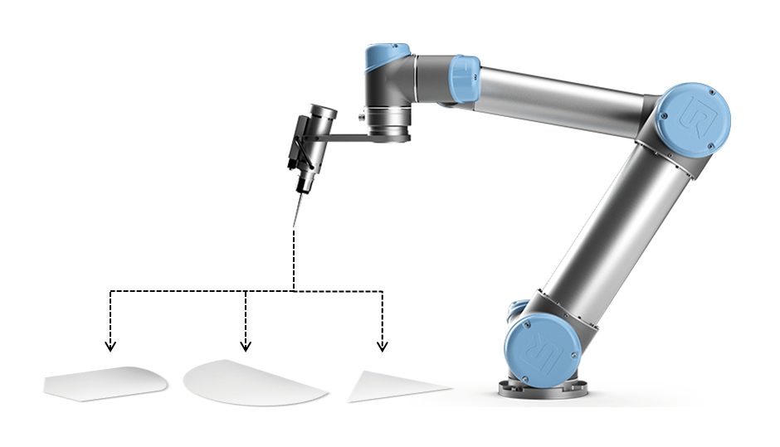
5
模块5：工艺应用带操作者选择项
培训师
循环指令
如何提醒操作者输入变量
用开关/案例指令创造程序逻辑
你的任务
建立一个应用程序能根据操作者输入执行3个不同的工件
成功标准
TCP正确设置
操作者选择工件去执行，用开关/案例检查操作者输入
每7个工件用循环语句移动机器人到服务位置，并且弹出一个信息
Notes:
Provide the learners with an overview of module 5
Explain what theory you will go through and how they are supposed to use the commands and functionalities in the task
Introduce the task and the related success criteria

Slide 41
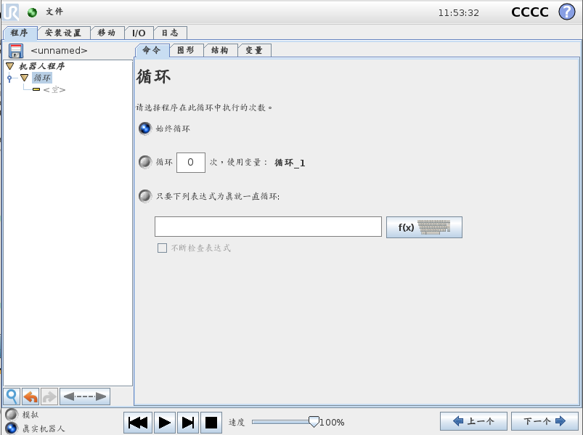
5
循环指令
定义
循环指令下面的程序执行条件
循环类型
永远循环
循环n次
循环<表达式>
Save sample program as loop.urp
Robot Program MoveJ Waypoint_5 Loop 3 times MoveL Waypoint_1 Waypoint_2 Waypoint_3 Waypoint_4 MoveJ Waypoint_5
Notes:
Loop
1. Open sample program movel_with_blend.urp
2. Add a loop with 3 loops.
3. Place the linear movements inside of the loop.
4. Add a start point above the first waypoint
5. Copy the start point to the end of program
6. Make sure to uncheck the box ”Program loops forever” in program settings

Slide 42
5
循环指令
中断
不断检查表达式
Save sample program as loop_interrupt.urp
Robot Program MoveJ Waypoint_5 Loop DI[0] = True MoveL Waypoint_1 Waypoint_2 Waypoint_3 Waypoint_4 MoveJ Waypoint_5
Notes:
Loop
Interrupt
1. Change loop setting and add the expression DI[0] = True
2. Connect an input to DI[0] and set it high
3. Check the box ”Check expression continuously”
Note that Loop changes name to While in CB2 4. Demonstrate the effect of setting the input DI[0] low while running

Slide 43
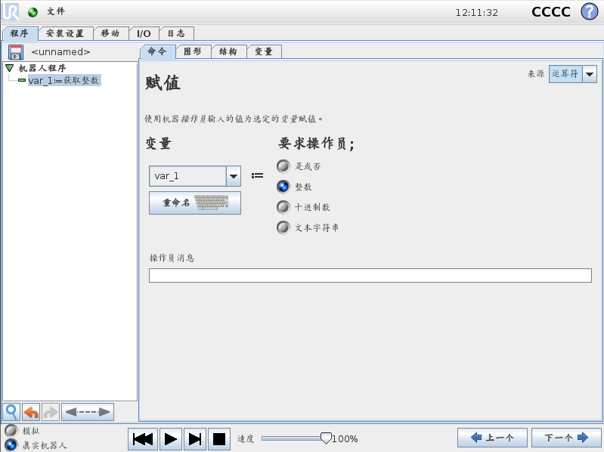
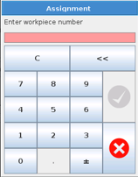
高级指令 2
6
操作者输入
由操作者赋值
选择变量来源
定义变量类型
写一条信息
Save sample program as var_operator_inputurp
Robot Program var_1 = 0 var_2 = operator input Loop var_1 < var_2 Pick_part Place_part var_1 = var_1 + 1
Notes:
Operator input
Modify sample program var_counter.urp:
1. Add local integer variable as operator input, which defines amount of loops
2. Change condition in Loop: Loop as long as var_1 < var_2
3. Uncheck ”Program loops forever” in program settings

Slide 44
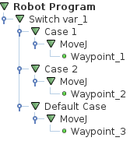
5
开关/案例 指令
创造程序逻辑并控制程序流程
Switch var_1
Case 1
Default case
Case 2
1
2
3
2
1
7
Waypoint_1
Waypoint_2
Waypoint_3
Notes:
THIS SLIDE CONTAINS MULTIPLE LAYERS, VIEW IT IN PRESENTATION MODE
Relate to ”assignment by operator” from previous slide
Explain how the operator input is assigned to var_1
The switch command uses var_1 as input
Provide a live demo similar to the slide example

Slide 45
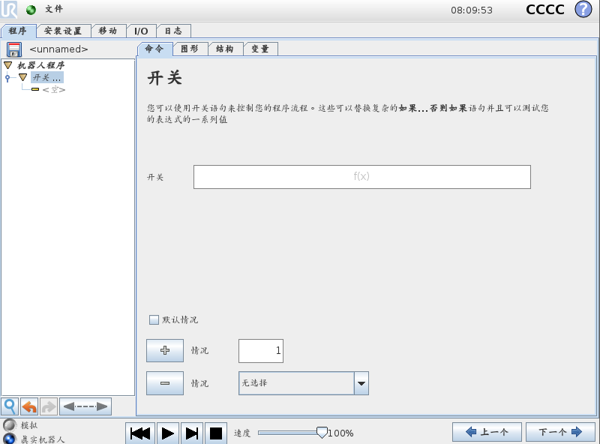
5
开关指令
开关案例
在表达式编辑器中设置条件
用+和 -号增加或减少一个案例
如果需要可选择一个默认案例

Slide 46
5
模块5：工艺应用带操作者选择项
培训师
循环指令
如何提醒操作者输入变量
用开关/案例指令创造程序逻辑
你的任务
建立一个应用程序能根据操作者输入执行3个不同的工件
成功标准
TCP正确设置
操作者选择工件去执行，用开关/案例检查操作者输入
每7个工件用循环语句移动机器人到服务位置，并且弹出一个信息
Notes:
Provide the learners with an overview of module 5
Explain what theory you will go through and how they are supposed to use the commands and functionalities in the task
Introduce the task and the related success criteria

Slide 47
5
模块5：工艺应用带操作者选择项
Success criteria
TCP is configured correctly
The operator selects workpiece to process and a switch/case is used to examine the input from the operator
Use the loop command to move the robot to a service position for every 7 workpieces and show a pop-up message
跟踪
问题/评论

Slide 48
6
模块6：安全设置
培训师
关节安全限制
通用安全限制
你的任务
在操作者区域内的人，用安全设置来限制碰撞风险
成功标准
操作者区域内的碰撞风险被消除
Notes:
Provide the learners with an overview of module 6
Explain what theory you will go through and how they are supposed to use the commands and functionalities in the task
Introduce the task and the related success criteria

Slide 49
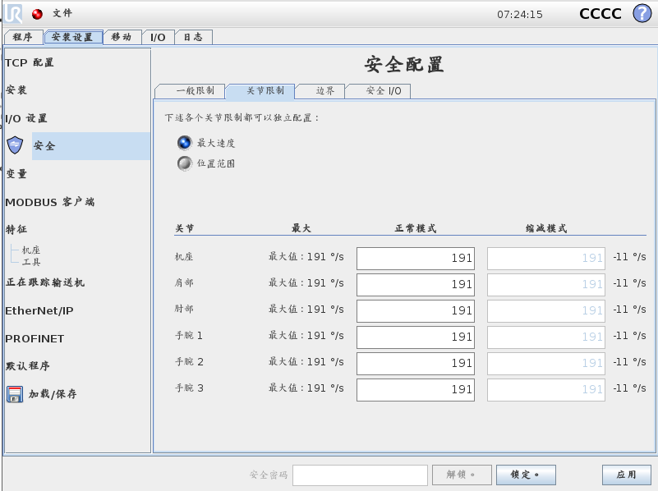
6
关节限制
最大速度
设置每个关节的最大速度
模式
正常模式
缩减模式
要求安全设置输入
Notes:
Joint limits
Limits for each joint can be set:
» Maximum speed
» Position range
Maximum speed is defined in degrees/sec

Slide 50
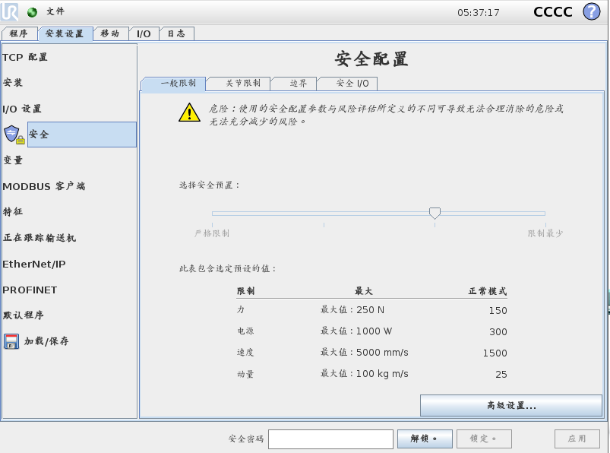
6
基本设置
安全设置
严格限制
限制
默认
限制最少
安全配置
同步
更改
无效的配置
保存配置
按“应用”
确认设置
Notes:
General limits
Change safety mode with slider
» Very restricted
» Restricted
» Default
» Least restricted
If any changes has been made to the safety configuration, a warning icon is displayed
» Press Apply to make new settings active

Slide 51
6
基本设置
默认设置
UR3 default Force(N) setting under Very restricted is 50
为理论最大值，如超过机器人将保护性停止
模式 | 严格限制 | 限制 | 默认 | 限制最少
力 Force (N) | 100* | 120 | 150 | 250
功率 Power (W) | 80 | 200 | 300 | 1000
速度 Speed (mm/s) | 250 | 750 | 1500 | 5000
动量 Momentum (kg·m/s) | 5 | 10 | 25 | 100
Notes:
Basic safety setting
Default settings for each mode

Slide 52
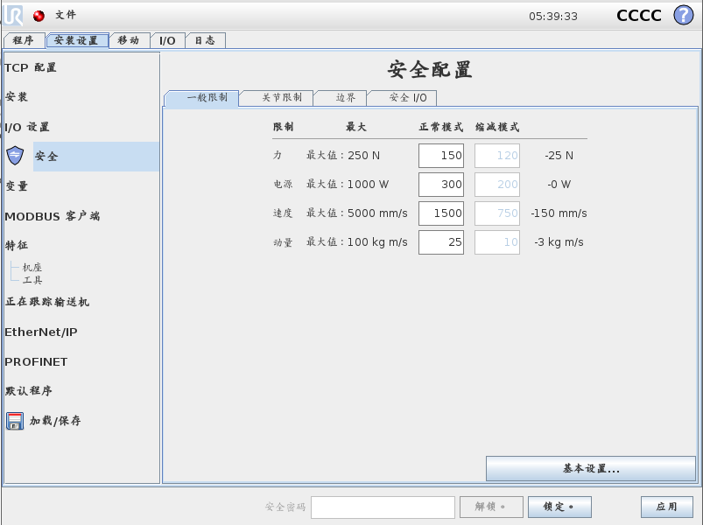
6
高级设置
个性化设置
力
功率
速度
动量
模式
正常模式
缩减模式
要求设置安全输入
Notes:
Advanced settings
In Advanced Settings it is possible to customize the settings
» Force
» Power
» Speed
» Momentum
Settings be be defined in:
» Normal mode
» Reduced mode (requires setup of safety input)

Slide 53
6
违反安全系统
在违反安全系统的状况下，机器人系统将进入恢复模式
恢复模式：
这个系统允许机器人手臂被手动拖动，直到所有的系统背离解决
当这个模式激活的条件下，不可能运行程序
在恢复模式下，关节位置限制无效
Notes:
Perform demo of Recovery mode

Slide 54
6
模块6：安全设置
培训师
关节安全限制
通用安全限制
你的任务
在操作者区域内的人，用安全设置来限制碰撞风险
成功标准
操作者区域内的碰撞风险被消除
Notes:
Provide the learners with an overview of module 6
Explain what theory you will go through and how they are supposed to use the commands and functionalities in the task
Introduce the task and the related success criteria

Slide 55
6
模块6：安全设置
Success criteria
The risk of collision in the operator area is eliminated
跟踪
问题/评论

Slide 56

7
模块7：灵活部署
培训师
什么是特征？
相对特征插入运动指令
你的任务
建立一个工艺应用程序，相对于一个平面特征编程
成功标准
仅仅通过改变特征就能改变工件位置
Notes:
Provide the learners with an overview of module 7
Explain what theory you will go through and how they are supposed to use the commands and functionalities in the task
Introduce the task and the related success criteria

Slide 57
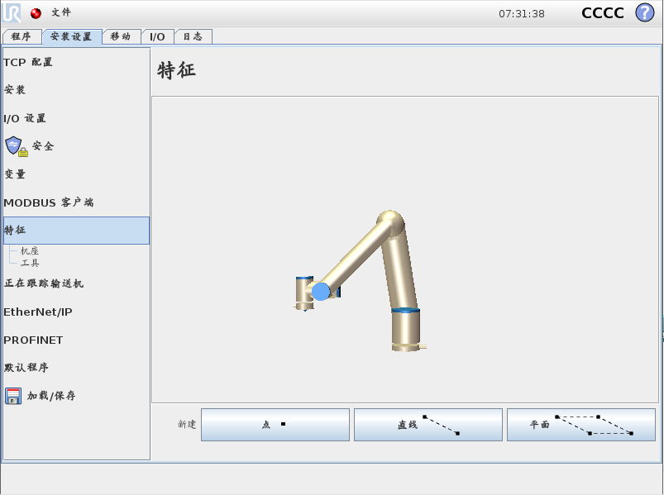
7
用户定义安全平面
特征
在PolyScope 1个平面是在特征里定义的
能设置多个特征平面
设置特征用
点
线
面
增加特征
平面
Notes:
User defined safety plane
Demonstrate how to define a feature as Plane
» Click Plane-button to add new plane

Slide 58
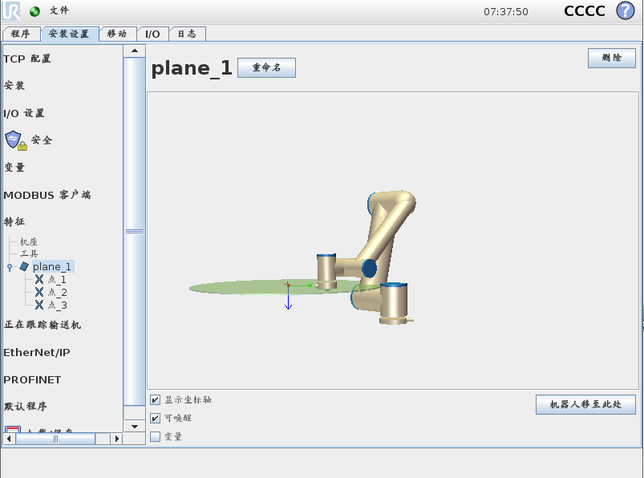
7
用户定义特征
可选项
重命名特征
删除特征
参数
显示坐标轴
可唤醒
变量
Notes:
User defined feature
A Plane can be:
» renamed
» deleted
A Plane has 3 parameters
» Show axes sets color on arrows in MOVE-tab
» Joggable enables/disables Feature in MOVE-tab
» Variable creates a copy of the Feature which can be used for mathematical calculations

Slide 59

7
用户定义特征
设置平面
平面包含3个固定点
示教垂直平面
点1 = 初始点
点2 = Y-方向
点3 = X-方向
Point_1
Point_2
Point_3
Notes:
User defined feature
Plane consists of 3 fixed waypoints
» Point_1 = origin of plane
» Point_2 = Y-direction of plane
» Point_3 = orientation of plane
Demonstrate how to define a feature as Plane
» Teach the 3 waypoints as a vertical plane

Slide 60
7
用户自定义特征
图例说明示教特征平面
保存安装设置文件
Notes:
User defined feature
Illustration of the taught Plane
» Save the Installation
Move robot here
» moves the robot so TCP is perpendicular to origin of Plane

Slide 61
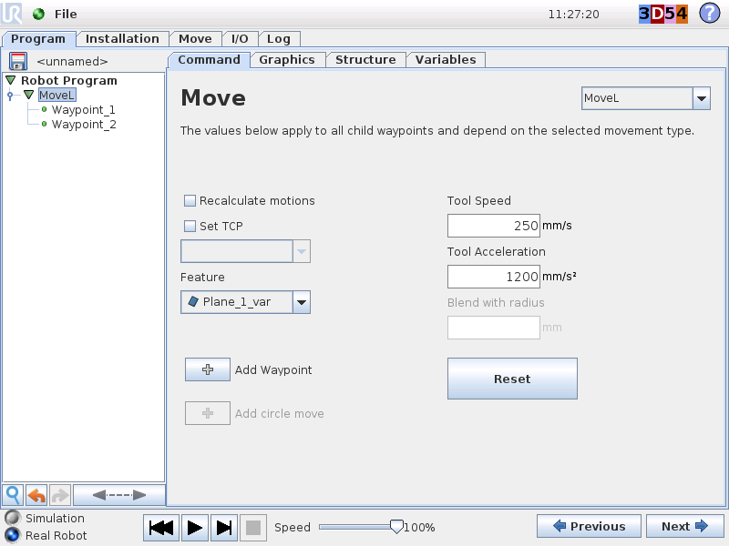
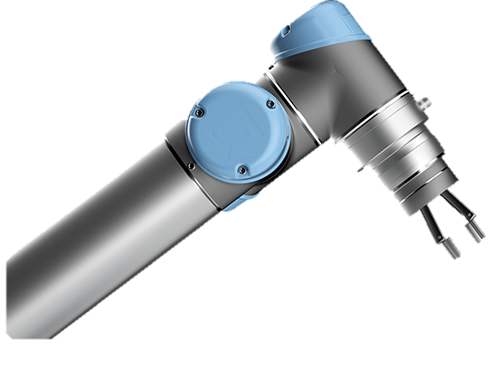
7
相对于特征编程
MoveL 和路点是相对于特征Plane_1_var
Waypoint_1
Plane_1_var
Waypoint_2
Notes:
THIS SLIDE CONTAINS MULTIPLE LAYERS, VIEW IT IN PRESENTATION MODE

Slide 62

7
相对于特征编程
如果特征变动，相对于特征的路点也会跟随变动
Waypoint_1
Waypoint_1
Plane_1_var
Plane_1_var
Waypoint_2
Waypoint_2
Notes:
THIS SLIDE CONTAINS MULTIPLE LAYERS, VIEW IT IN PRESENTATION MODE

Slide 63
7
模块7：灵活部署
培训师
什么是特征？
相对特征插入运动指令
你的任务
建立一个工艺应用程序，相对于一个平面特征编程
成功标准
仅仅通过改变特征就能改变工件位置
Notes:
Provide the learners with an overview of module 7
Explain what theory you will go through and how they are supposed to use the commands and functionalities in the task
Introduce the task and the related success criteria

Slide 64
7
模块7：灵活部署
Success criteria
The location of the workpiece can be changed by only changing one feature
跟踪
问题/评论

Slide 65
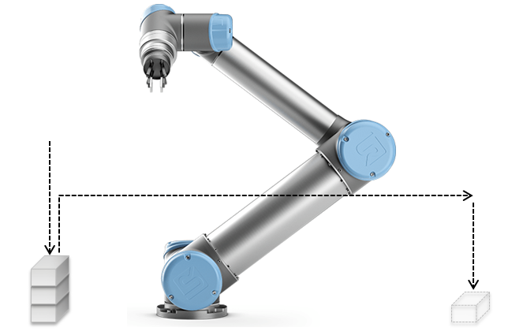
8
模块8：利用力反馈拆垛应用
培训师
线程
力反馈
向导：探寻
你的任务
创建一个应用程序：可以把托盘上4个工件移动到其他位置
成功标准
用力反馈功能检测工件
用探寻向导移动工件
在不触发保护性停止情况下，所有工件被移走
Notes:
Provide the learners with an overview of module 8
Explain what theory you will go through and how they are supposed to use the commands and functionalities in the task
Introduce the task and the related success criteria

Slide 66
8
线程/事件
Robot prg Event Thread
Start
线程（Thread）
平行处理程序
连续运行
事件（Event）
平行处理程序
被条件触发
目的
用于与其他设备的I/O通讯，做复杂运算等
DO[0] = HI
Trigger: DO[0] = HI
DO[0] = LO
Stop
Notes:
Thread
» Program running parallel with robot program
» Continuously running when robot program is running
Multiple amount of threads can run at same time
Limitation:
» If many threads are running, it can influence CPU load
» If threads contain complex operations, it can influence CPU-load
Event
» Process running parallel with robot program
» Event will run if a specified condition is True (trigger the event)
Limitation:
» Only one event can be executed at a time

Slide 67
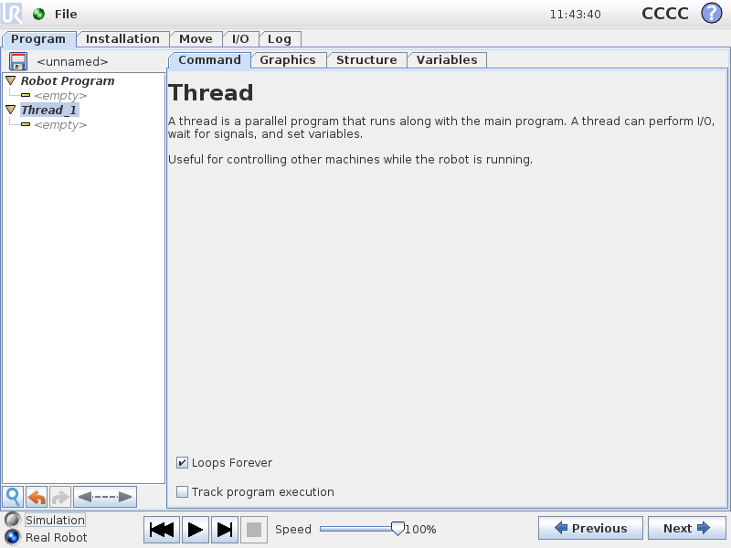
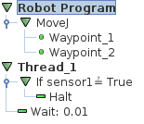
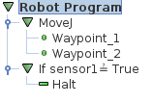
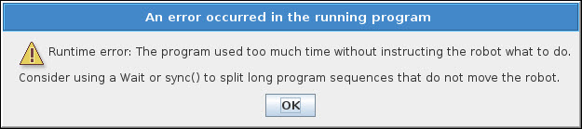
8
线程
设置
程序永远循环
跟踪程序执行
Notes:
Thread
1. Create sample program where a digital input will Halt the program execution.
2. Demonstrate that the input is checked only when robot has arrived at Waypoint_2
3. Add thread and check state of input in thread
4. Demonstrate that input is checked continuously during program execution
NOTE: Inform that a thread normally always should contain a WAIT 0.01 or sync() in order to avoid infinite loop in thread.

Slide 68
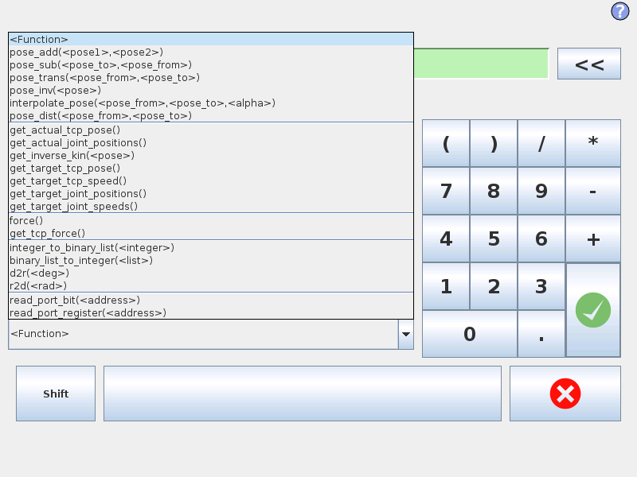
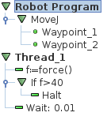
8
力反馈
用内部力反馈作为传感器
Notes:
How to use script
Create sample program:
1. Insert vertical linear movement between two waypoints.
2. Reduce speed to 100 mm.
3. Move the bottom waypoint inside of an IF-command
4. Define condition in IF to be force() < 40 :it might be required to adjust the value
5. IMPORTANT: Make sure to check the box ”Check expression continuously”
Demonstrate how it is possible to stop the downward movement by hand.
Show the variable tab and verify the force value changes while running the program

Slide 69

8
探寻向导
堆垛
在堆栈上添加物体
拆垛
从堆栈上拆除物体
Notes:
Seek
Seek operation consists of two types:
» Stacking
» Destacking

Slide 70

8
拆垛
样板
在程序中加入探寻（seek）
选择拆垛（Destack）
拆垛
设置起始点
从哪开始探寻工作
设置堆栈方向
是直线方向
从某点
到某点
设置物体厚度
所有物体厚度相同
设置传感器输入
为了知道什么时候物体被发现
用force() > 50
4
Notes:
Destacking
Create sample program
Add Seek-command
Select Destack

Slide 71

8
拆垛
拾取顺序（PickSequence）
堆栈点（StackPos）
定义从哪抓取物体
点（Wayoint）
定义拾取后如何退出
定义行动
设置
等待
经验法则：示教StackPos与StartPos是同一个点
Notes:
Destacking
Teach points in PickSequence
- rule of thumb is to teach PatternPoint as same point as StartPos
- teach Waypoint point as how to exit after finding next position
Define actions
- define SET and WAIT commands in sequence

Slide 72
8
模块8：利用力反馈拆垛应用
培训师
线程
力反馈
向导：探寻
你的任务
创建一个应用程序：可以把托盘上4个工件移动到其他位置
成功标准
用力反馈功能检测工件
用探寻向导移动工件
在不触发保护性停止情况下，所有工件被移走
Notes:
Provide the learners with an overview of module 8
Explain what theory you will go through and how they are supposed to use the commands and functionalities in the task
Introduce the task and the related success criteria

Slide 73
1
模块8：利用力反馈拆垛应用
Success criteria
The force feedback function must be used to detect the workpieces
The seek wizard must be used to move the workpieces
All workpieces can be removed without triggering protective stop
跟踪
问题/评论
Notes:
Follow-up
why it is necessary to insert a wait command in the thread
Explain/show how it is possible to make a more accurate/sensitive application using only get_tcp_force()

Slide 74
9
模块9：容易启动
培训师
BeforeStart 序列
相对路点
当主电源开机后，加载默认程序，自动初始化和启动程序
你的任务
当开机后，设置机器人加载拆垛应用程序，自动初始化和启动程序
成功标准
拆垛应用程序自动加载
机器人自动初始化和启动程序
Notes:
Provide the learners with an overview of module 9
Explain what theory you will go through and how they are supposed to use the commands and functionalities in the task
Introduce the task and the related success criteria

Slide 75

9
BeforeStart 序列
BeforeStart
这个序列仅仅在程序开始前运行一次
能被用于
设置输出信号和变量为默认状态
运动机器人到home点
机器人程序
默认程序永远循环
Notes:
BeforeStart Sequence
In order for program to auto-start its operation without the operator being presented with the Auto-Move screen, a before start sequence can be used if this contains a relative or variable position as first waypoint.
This will skip the Auto-move screen.
BE AWARE that robot will move, possible with higher speeds, so this functionality needs to be considered carefully

Slide 76

基本指令 1
3
相对路点
相对运动
线性移动
在程序中相对前一个位置
显示距离和角度
提示：如果第一个路点为相对路点，机器人将跳过“自动”回初始点操作，并移动到相对距离
Notes:
Relative waypoint
A relative position is a movement that is relative to the prior position.
Relative position is defined by two teached waypoints.
The linear distance and angle displacement is displayed after both waypoints has been taught.
The waypoints can be teach anywhere in robot workspace, robot will still move relative to prior position.
NOTE: If no prior position exist in program, the robot will move relative from actual position when starting program.
IMPORTANT NOTE: Robot will move directly without displaying AutoMove screen if first waypoint in program is a relative position.
Open sample program movel.urp:
» Keep first waypoint as fixed.
» Set the following three waypoints to relative positions:
For each relative position use the prior waypoint as the from point.
Robot Program
MoveL
Waypoint_1
Waypoint_2 rel. pos
Waypoint_3 rel. pos
Waypoint_4 rel. pos
PERFORM LIVE DEMO
Now modify only Waypoint_1 (the fixed position) and demonstrate how the entire rectangle is shifted
PERFORM LIVE DEMO
Save program as movel_with_relative_waypoint.urp

Slide 77

9
默认程序
目的
设置机器人可以自动启动，不需要操作者干预
如何做
选择默认程序
设置数字输入信号自动启动
设置数字输入信号自动初始化
保存安装设置
重新启动机器人
注意：机器人将总是在启动时导入默认（default）安装设置文件
Notes:
Def. program
Robot can be setup to start automatically with no operator interaction needed.
How to:
» Select digital input to initialize after powerup (= brake release)
- signal must be high when booting
» Select default program to load
» Select digital input to start program
- recommended to set signal low after program is started
» Save installation as default.installation
Reboot in order to take effect.
PERFORM LIVE DEMO

Slide 78
9
模块9：容易启动
培训师
BeforeStart 序列
相对路点
当主电源开机后，加载默认程序，自动初始化和启动程序
你的任务
当开机后，设置机器人加载拆垛应用程序，自动初始化和启动程序
成功标准
拆垛应用程序自动加载
机器人自动初始化和启动程序
Notes:
Provide the learners with an overview of module 9
Explain what theory you will go through and how they are supposed to use the commands and functionalities in the task
Introduce the task and the related success criteria

Slide 79
9
模块9：容易启动
Your tasks
Set up the robot to load the destacking application, auto-initialize and start program when the main power is turned on
跟踪
问题/评论
Notes:
Answer questions/comments
Asks participants about pros/cons of using a relative waypoint in the before start sequence

Slide 80

10
在线资源：下载和小窍门
http://www.universal-robots.cn/support/
常见问题回答（FAQ）
如何做（How to’s）
下载
魔法文件（Magic files）
固件（Software firmware）
模拟软件（URSim）
日志阅读器（Log reader）
CAD 图纸
手册
Notes:
UR support site
Demonstrate support site and navigate through the site.

Slide 81

11
11
附录：
通用
“关于”屏幕
嵌入式手册
设置机器人
语言和单位
更新机器人软件
设置密码
标定屏幕
设置网络
设置时间和日期
URCaps 设置
安装设置
最大负载计算
安装
I/O 动作设置
可调节的安全设置
3位置使能设置
Modbus TCP
Ethernet/IP
ProfiNet
编程
编辑区域 / Dashboard
变量范围
事件
URScript介绍
力控制
其他
魔法文件
软件更新
固件更新
URSim
日志历史
Support Log Reader
用户界面：工具端接头
安全
标准
TÜV 认证
风险评估

Slide 82

11
关于
信息
系列号
软件版本号
IP地址
V3.3版将显示安全控制板固件版本号
Notes:
Press About and popup will appear with information about software version
Serial number of robot and IP-address are informed as well
From 3.2 it will also show the firmware version of the safety control board

Slide 83

11
嵌入式手册
特点
用选用的语言显示
软件使用手册的“简洁”版本
Notes:
Online manual will be displayed in the selected language
The online manual is a light version of the software manual

Slide 84

11
设置机器人
设置机器人
针对系统软件的设置

Slide 85

11
设置机器人
系统软件设置
初始化机器人
语言和单位选择
更新机器人
设置密码
校准屏幕
设置网络
设置时间
URCaps设置
Notes:
In Setup Robot menu it is possible to adjust the software settings.
Focus on:
INITIALIZE Robot
LANGUAGE and UNITS
Set PASSWORD
CALIBRATE Screen
SET Time
Other options will be explained later

Slide 86
11
初始化机器人
机器人状态
初始化机器人
检查负载设置
点“开”：上电
点“启动”：释放刹车
反驱动模式
当靠近碰撞区域，用反驱动模式拉机器人手臂到安全位置
State | Power | Brakes
 | OFF | Engaged
 | ON | Engaged
 | ON | Released
Notes:
Initialize robot is where the robot can be initialized = mechanical brakes are released
Payload:
Payload specifies the weight of end-of-arm tooling.
It will automatically use the value defined in the Intallation, but can manually be changed if another or no tool is mounted.
In case the payload is defined incorrect and brakes are released, the robot will make a security stop and turn off the power.
(payload value must differ significantly to generate a security stop)
Procedure for initializing:
1. Check payload settings correspond with weight of actual end-of-arm tool STATE: POWER OFF
2. Press ON to enable power for the joints STATE: IDLE
3. Press ON again to release the mechanical brakes STATE: NORMAL
PERFORM LIVE DEMO
If robot is close to collision, the BACKDRIVE function can be used to move robot arm to safe position before initializing.
Backdrive mode:
Press ON to enable power for the joints.
Do NOT release the brakes.
2. Press and hold Freedrive» status will change to BACKDRIVE
3. Pull joint away from collision area » brake is released for only this joint as long as freedrive is pressed.
PERFORM LIVE DEMO of BACKDRIVE MODE

Slide 87

11
语言和单位
语言
20 种语言
编程选用英语时可保持程序指令名字为英语
单位
公制
英制
Notes:
In Language and Units it is possible to set the language of the software.
20 languages available
English programming names can be selected (all command-names will be kept in English independent of language selection) Bug in 3.1.16941
NOTE: Keyboard is fixed as English, even though language is not set to English
Units can be set as metric or US
Press ”Restart Now” in order for new settings to take effect.

Slide 88

11
更新机器人
机器人软件
免费更新
从优傲技术支持网站下载
www.universal-robots.com /support
注：更新步骤将在后续的培训中讲到
Notes:
PolyScope can be updated.
Normally a new software release is available twice a year.
It can be downloaded on UR support site.
How-to procedure will be covered later in training session.

Slide 89

11
设置密码
系统密码
密码保护限制进入软件
安全密码
修改安全设置时需要密码
Notes:
Parts of the software can be password protected.
Passwords can consist of any ascii characters.
Two types of password:
» System password
This password is limiting access to parts of the software, so operators can only load/start/stop programs.
No editing can be done without entering password
Masterpassword: Automatica2010
» Safety password
This password is for limiting access to changing the safety settings.

Slide 90

11
校准屏幕
校准触摸屏
点中四个角的校准符号
Notes:
Calibration of touch screen.
Can be used in case the touch screen is out of adjustment.
Procedure:
1. Mark first corner with UR laserpen as precise as possible
2. Follow same procedure for the last three corners
3. Apply calibration by pressing OK

Slide 91

11
设置网络
网络参数配置
在这个菜单能设置机器人的IP地址
操作步骤在后续的培训中讲到
Notes:
In this menu the network configuration of controller can be set.
Live demo will be performed later in training session.

Slide 92

11
设置时间
时间
时间格式
24 小时
12 小时
日期
日期格式
Notes:
Set time is for setting time and date of software.
Press ”Restart Now” in order for new settings to take effect.
Go back to Welcome screen and enter PROGRAM ROBOT

Slide 93

11
URcaps
能够用UR操作流程集成第三方软件解决方案
在核心培训中不包含
Notes:
Full info can be found on support site
http://www.universal-robots.com/how-tos-and-faqs/faq/ur-faq/release-note-software-version-33xx/

Slide 94


11
最大负载计算
最大允许负载
需要根据重心补偿
重心和最大负载的关系（UR3）
重心Center of Gravity (CoG) = 100 mm
Notes:
Example of how to calculate payload in respect to tool with total length of 200 mm.
PERFORM LIVE DEMO

Slide 95

11
安装
设置机器人基座如何安装
Notes:
In Mounting it is possible define how the robot physically is mounted.
Always make sure to define/verify the mounting before initializing the robot.

Slide 96

11
I/O 设置
输入
重命名信号名字
设置I/O动作
启动程序
停止程序
暂停程序
自由驱动
当重命名时，程序和I/O窗口也会变化
Notes:
I/O setup
In I/O setup it is possible to rename I/O’s.
The renaming will have effect both on I/O monitor tab and in robot program.
For outputs properties for an output can be altered:
» [I/O tab control] enables/disables that operator can force an output from the I/O tab (also during run of program)
» [SET to … when program is not running] checkbox forces the output to a specified status when program is stopped/security stopped
Modify name for output used in sample program and demonstrate the consequence.

Slide 97

11
I/O 设置
输出
重命名信号
I/O 动作控制
在停止时设置输出信号状态
当重命名时，程序和I/O窗口也会变化
Notes:
I/O setup
In I/O setup it is possible to rename I/O’s.
The renaming will have effect both on I/O monitor tab and in robot program.
For outputs properties for an output can be altered:
» [I/O tab control] enables/disables that operator can force an output from the I/O tab (also during run of program)
» [SET to … when program is not running] checkbox forces the output to a specified status when program is stopped/security stopped
Modify name for output used in sample program and demonstrate the consequence.

Slide 98

11
I/O 设置
输出
重命名信号
I/O 动作控制
在停止时设置输出信号状态
当重命名时，程序和I/O窗口也会变化
Notes:
I/O setup
In I/O setup it is possible to rename I/O’s.
The renaming will have effect both on I/O monitor tab and in robot program.
For outputs properties for an output can be altered:
» [I/O tab control] enables/disables that operator can force an output from the I/O tab (also during run of program)
» [SET to … when program is not running] checkbox forces the output to a specified status when program is stopped/security stopped
Modify name for output used in sample program and demonstrate the consequence.

Slide 99

11
安全特征
可配置的安全设置
高级和专利保护的安全设置
多重安全设置
密码保护
目的
安全参数根据应用可以单独调整
确保对个人和外围设备没有伤害
风险评估
当安装机器人应用时总是做风险评估
可配置安全设置应用于风险评估
Notes:
Safety
Robot is equipped with an advanced safety system.
Consult User Manual Chapter 10: Safety Configuration

Slide 100
11
安全密码
安全设置由密码保护
锁住
保护安全设置
解锁
可修改安全参数
设置安全密码
到“设置机器人”
选择设置密码
输入密码
按“应用”
Notes:
Safety Password protection
Safety settings are password protected.
Demonstrate how to protect safety settings:
» Set safety password under SETUP/SET PASSWORD
» Press Apply
» Go to PROGRAM ROBOT\INSTALLATION\SAFETY and verify that safety settings are password protected
» Unlock/lock settings
PERFORM LIVE DEMO

Slide 101
11
基本设置
安全设置
严格限制
限制
默认
限制最少
安全配置
同步
更改
无效的配置
保存配置
按“应用”
确认设置
Notes:
General limits
Change safety mode with slider
» Very restricted
» Restricted
» Default
» Least restricted
If any changes has been made to the safety configuration, a warning icon is displayed
» Press Apply to make new settings active

Slide 102
11
基本设置
默认设置
UR3 default Force(N) setting under Very restricted is 50
为理论最大值，如超过机器人将保护性停止
模式 | 严格限制 | 限制 | 默认 | 限制最少
力 Force (N) | 100* | 120 | 150 | 250
功率 Power (W) | 80 | 200 | 300 | 1000
速度 Speed (mm/s) | 250 | 750 | 1500 | 5000
动量 Momentum (kg·m/s) | 5 | 10 | 25 | 100
Notes:
Basic safety setting
Default settings for each mode

Slide 103
11
高级设置
个性化设置
力
功率
速度
动量
模式
正常模式
缩减模式
要求设置安全输入
Notes:
Advanced settings
In Advanced Settings it is possible to customize the settings
» Force
» Power
» Speed
» Momentum
Settings be be defined in:
» Normal mode
» Reduced mode (requires setup of safety input)

Slide 104
11
安全模式
正常模式
默认激活的安全模式
缩减模式
当TCP位置超过“触发缩减模式平面”时激活
当收到可配置输入信号为“触发缩减模式”时激活
违例案例：
恢复模式
当机器人手臂背离一个或多个安全模式
允许手动调整机器人手臂，直到所有违例恢复
在这种模式下不可能运行程序
在恢复模式下关节位置限制失效
Notes:
Safety modes
Explanation of the different modes

Slide 105

11
安全校验和
校验和
可视化安全配置
用颜色和数字标识
当修改安全参数，校验和将随机改变
Notes:
Checksum
Checksum is a visible indication of safety configuration
» located in top right corner.
» checksum is indicated as colors and numbers
Click on checksum to display details about configuration

Slide 106
11
关节限制
最大速度
设置每个关节的最大速度
模式
正常模式
缩减模式
要求安全设置输入
Notes:
Joint limits
Limits for each joint can be set:
» Maximum speed
» Position range
Maximum speed is defined in degrees/sec

Slide 107

11
关节限制
位置范围
设置每个关节位置范围
模式
正常模式
缩减模式
要求安全设置输入
Notes:
Joint limits
Position range can be limited
» Min. limit
» Max. limit
Position range is defined in degrees

Slide 108

11
边界
安全平面
限制允许的工作范围
8 个平面能被定义
在示教和运行程序时激活
当TCP进入平面时可以触发缩减模式
重要：安全边界只限制TCP，不全部限制机器人手臂
Notes:
Boundaries
A safety plane is a way of defining a confined space
IMPORTANT:
Safety boundary defines a limit only for robot TCP, not overall limit for robot arm
» part of the arm can be on ”wrong” side of plane and if TCP is on allowed side, it is possible to move robot

Slide 109


11
边界
设置平面
设置特征平面
定义使用的平面
设置安全模式
定义当安全平面被激活时
位移
安全平面平移
应用
激活参数改变
Notes:
Boundaries
A safety plane is a way of defining a confined space
IMPORTANT:
Safety boundary defines a limit only for robot TCP, not overall limit for robot arm
» part of the arm can be on ”wrong” side of plane and if TCP is on allowed side, it is possible to move robot

Slide 110
11
安全模式
安全模式行为
安全模式 | 行为
禁用 | 不激活
正常 | 在正常模式下为“硬限制”
缩减 | 在缩减模式下为“硬限制”
二者都是 | 在任何时候为“硬限制”
触发缩减模式 | 当TCP进入这个平面时，机器人为缩减模式
Notes:
Safety Modes
Explain the different Safety Modes:
» Disabled inactive
» Normal acts as ”hard limit” when in normal mode
» Reduced acts as ”hard limit” only if robot is in reduced mode
» Normal & Reduced acts as ”hard limit” at all times
» Trigger Reduced Mode robot switches to reduced mode when TCP is entering plane

Slide 111

11
安全边界行为
测试
设置特征平面 = 基座
设置安全模式 = 正常
应用设置
在示教模式下测试安全
移动机器人从正常区域到安全区域
运行程序行为
程序执行将停止，弹出窗口显示安全背离
正常区域
”硬限制”
安全区域
Notes:
Behavior of safety boundary
Safety boundary works both in:
» Teach mode
» Run mode
PERFORM LIVE DEMO
Teach mode:
» Press freedrive button
» Move robot from Normal area towards Safety area
» robot will stop on ”hard limit” / operator will feel higher resistance when trying to move robot into the safety area

Slide 112
11
触发缩减模式
测试
改变安全模式到：触发缩减模式
设置缩减模式最大速度：350 mm/s
应用设置
保存 safety.installation
Save sample program as trigger_reduced_mode.urp
进入缩减模式
Normal area
p1
Robot Program MoveL Waypoint_1 Waypoint_2 Waypoint_3 Waypoint_4
p4
”hard limit”
退出缩减模式
p2
Safety area
正常速度
p3
缩减速度
Notes:
Trigger reduced mode
Create sample program with four points
» First waypoint outside of safety area
» Next two waypoints inside of safety area
» Last waypoint outside of safety area
» Run sample program and verify that TCP speed slows down when inside of safety area

Slide 113
11
用户定义安全平面
特征
在PolyScope 1个平面是在特征里定义的
能设置多个特征平面
设置特征用
点
线
面
增加特征
平面
Notes:
User defined safety plane
Demonstrate how to define a feature as Plane
» Click Plane-button to add new plane

Slide 114



11
用户定义安全平面
可选项
特征重命名
删除特征
参数
显示坐标轴（在移动窗口显示坐标轴颜色）
可唤醒（在移动窗口激活特征）
变量（可创建一个用于数学计算的拷贝）
Notes:
User defined safety plane
A Plane can be:
» renamed
» deleted
A Plane has 3 parameters
» Show axes sets color on arrows in MOVE-tab
» Joggable enables/disables Feature in MOVE-tab
» Variable creates a copy of the Feature which can be used for mathematical calculations

Slide 115

11
用户定义安全边界
设置平面
平面包含3个固定点
示教垂直平面
点1 = 初始点
点2 = Y-方向
点3 = X-方向
Notes:
User defined safety plane
Plane consists of 3 fixed waypoints
» Point_1 = origin of plane
» Point_2 = Y-direction of plane
» Point_3 = X-direction of plane
Demonstrate how to define a feature as Plane
» Teach the 3 waypoints as a vertical plane

Slide 116
11
用户定义边界
图形化显示示教平面
保存安装设置
Notes:
User defined safety plane
Illustration of the taught Plane
» Save the Installation
Move robot here
» moves the robot so TCP is perpendicular to origin of Plane

Slide 117

11
用户定义安全边界
设置新的安全边界
设置特征平面为： Plane_1
设置安全模式为： 触发缩减模式（Trigger Reduced Mode）
应用设置
Save sample Installation file as safety.installation
Notes:
User defined safety plane
Demonstrate how to use the Feature as safety plane

Slide 118

11
用户定义安全边界行为
测试
示教模式
移动机器人从正常区域到安全区域
运行模式
运行简单程序，并且观察TCP速度的改变
Save sample program as trigger_reduced_mode_feature.urp
进入缩减模式
p2
p1
Robot Program MoveL Waypoint_1 Waypoint_2
正常速度
缩减速度
Notes:
User defined safety plane
Demonstrate how to use the Feature as safety plane

Slide 119

11
工具边界
限制TCP背离的角度
根据选择的特征，设置TCP最大背离
测试
设置特征平面： Base
设置背离： 20°
设置安全模式为：正常和缩减模式
应用
在示教模式下测试
Notes:
Tool Boundary
The tool boundary restricts the angular deviation of TCP, so tool always orientate within the defined limit.
Demonstrate how to setup a the tool boundary
» Tilt TCP by either jogging in MOVE-menu or teach mode
» Verify a warning pops up if deviation limit is exceeded

Slide 120

11
安全 I/O
安全功能
安全功能可被安排到可配置 I/O’s
所有功能为双通路
每一个功能用两个信号
种类 3, PLd
可配置 I/O’s
数字输入
数字输出
Notes:
Safety I/O
It is possible to setup safety I/O’s on the robot
All safety signals are redundant, meaning that the system controls two channels.
Two signals are required for each safety input/output.
The safety signals can be assigned to the configurable I/O’s on Safety Control Board.

Slide 121

11
安全输入信号
安全输入
紧急停止
用于连接外部急停按钮或安全PLC
缩减模式
信号低：机器人在正常模式下
信号高：机器人在缩减模式下
防护重置
如果安全控制板上SI0和SI1被连接，用这个信号可以复位安全回路
3-位置开关
见下一页
Notes:
Safety inputs

Slide 122

11
安全输入信号
安全输入信号
3-位置开关
可以在安全控制板上接线
操作模式
当3-位置开关被选择时才能选择
Notes:
3-point switch
Must have minimum SW3.2 AND safety control board with firmware Safety processor A: 473 Safety processor B: 212 – see slide 18
How to setup and use can be found in under manual and How To on support site.

Slide 123

11
安全输出信号
安全输出信号
系统紧急停止
高：正常模式
低：急停:
机器人运动
高：机器人不运动
低：机器人正在运动
机器人未停止
高：机器人要求停止，直到停止前信号为高
低：没有停止要求
缩减模式
高：正常模式
低：缩减模式
非缩减模式
缩减模式状态取反
Notes:
Safety outputs
Safety outputs:
» System Emergency Stop high signal indicates robot is in normal mode, low signal indicates robot is emergency stopped
» Robot Moving high signal indicates robot is in fixed position, low signal indicates robot is moving
» Robot Not Stopping if robot has been requested to stop, signal will be high until robot stops. If no request, signal will be low
» Reduced Mode high signal indicates robot is in normal mode, low signal indicates robot is in reduced mode
» Not Reduced Mode inverse state of Reduced Mode

Slide 124

11
3点使能设备和模式选择器
Notes:
Ment as an extra slide that can be enabled if 3PS is on the agenda.

Slide 125
11
什么是Modbus TCP？
Modbus TCP
基于以太网的通讯协议
通讯协议
协议是设备之间通讯的通用语言
可以在设备间传输数据
客户端（Client）/服务器（ Server） 的关系
设备1
设备 2
以太网
数据
Notes:
Destack
Add folder to sample program

Slide 126
11
客户端/ 服务器
服务器 （从设备）
一个设备作为服务器
监听来自客户端的请求
客户端（主设备）
其他设备作为客户端
向服务器发送请求
每个设备必须有唯一的IP地址
设备1
请求
设备 2
回答
Notes:
Client / Server
Client/Server is sometimes referred to as Master/Slave
Client = Master
Server = Slave

Slide 127
11
数据类型
用于Modbus TCP通讯的数据类型
地址范围
每一个数字信号和寄存器都有唯一的地址
地址由供应商技术文档说明
数据类型 | 值 | 地址范围
数字输入 | On/Off | 相关文档由服务器供应商提供
数字输出 | On/Off
寄存器输入 | 16 bit
寄存器输出 | 16 bit
Notes:
Client / Server
Client/Server is sometimes referred to as Master/Slave
Client = Master
Server = Slave

Slide 128

11
Modbus TCP
例子
用机器人做客户端并连接到服务器
外部设备
以太网
Modbus客户端
Modbus 服务器
Notes:
Data types
Available data types

Slide 129

11
设置网络
设置
选择静态网址
设置机器人IP地址
设置子网掩码
按“应用”保存设置
提示：用“更新”按钮是ping其他设备:
Notes:
Setup Network
Setup:
» Static address
» Set IP-address of controller (Client)
» Set Subnet mask
Press ”Apply” to save configuration in file on disk
”Update” button can be used for ”pinging” the other device

Slide 130


11
服务器
Phoenix 模块 ILB ETH 24 DI16 DIO16 2TX
16 数字输入
16 数字输出
2 个网口
Notes:
Server
Device used in this sample:
Phoenix Contact ILB ETH 24 DI16-DIO16-2TX
Documentation from vendor
Signal: Address range:
Digital output 0-15
Digital input 16-32

Slide 131

11
设置服务器
设备设置
增加新设备
设置新设备的IP地址（服务器）
信号设置
增加新设备
增加信号
定义数据类型
设置信号地址
定义信号名字
Notes:
Setup Server
How to setup external I/O device for adding additional I/O’s to the system

Slide 132

11
设置服务器
设置
设置2个数字输入信号
设置2个数字输出信号
保存在安装设置中
监测
信号能够在I/O窗口中检测
连接状态
 | 状态
 | 连接OK
 | 更新频率警告
 | 没有连接
E4 | 异常代码
Notes:
Setup Modbus
Demonstrate how the outputs can be monitored in I/O tab during run of program.
Exception codes
Press ?-mark in top right corner and then on E-code to access online info about the code
The server (external device) responds error messages with exception codes:
0x01: ILLEGAL_FUNCTION_CODE
0x02: ILLEGAL_DATA_ACCESS (if the request address is illegal)
0x03: ILLEGAL_DATA_VALUE (if the request data is invalid)
0x04: SLAVE_DEVICE_FAILURE (error has occured in the external device)
0x05: ILLEGAL_DATA_VALUE (if the request data is invalid)
0x06: SLAVE_DEVICE_BUSY (if slave (server) is not able to respond now)

Slide 133

11
在程序中用Modbus信号
信号使用
和正常的数字信号功能相同
Save sample program as modbus.urp
Robot Program MoveL Waypoint_1 Set MODBUS_1 = True Waypoint_2 Waypoint_3 Waypoint_4 Set MODBUS_1 = False
Notes:
Use of Modbus signals
Open sample program set.urp
Replace digital output in SET-commands with Modbus digital output

Slide 134

11
Ethernet IP
Ethernet IP
作为默认是不激活的
从SW 3.2版以后生效
在核心课程培训时不包括

Slide 135

11
PROFINET
PROFINET
作为默认是不激活的
从SW 3.3版以后生效
在核心课程培训时不包括
http://www.universal-robots.com/how-tos-and-faqs/how-to/ur-how-tos/profinet-guide-20596/
http://www.universal-robots.com/how-tos-and-faqs/faq/ur-faq/release-note-software-version-33xx/
Notes:
http://www.universal-robots.com/how-tos-and-faqs/how-to/ur-how-tos/profinet-guide-20596/
http://www.universal-robots.com/how-tos-and-faqs/faq/ur-faq/release-note-software-version-33xx/

Slide 136

11
力控

Slide 137

11
力指令
特点
和环境融合
调整机器人位置来达到定义的力
技术参数
力控精度 ± 10 N
扭矩精度 ± 5 Nm
位置精度 ± 5 mm
方向精度 ± 0.5 °
Notes:
Force
Introduction to Force mode:
» In Force mode the robot will comply with its surroundings
- meaning it will automatically adjust its position to achive a specified force
» Force mode is NOT a safety feature
Limitations:
» Working range is limited, required to make tests to find optimal workspace
» Precision is limited to appr. +/-10 N
» Singularity might occur depending on posture of robot arm

Slide 138

11
如何使用力
设置
力类型
力数值
力方向
很容易测试
示教测试
Notes:
How to use Force
How to use:
» Set Force type
» Set Force level (in Newton)
» Set direction of force

Slide 139

11
力控类型：简单
特点：
单轴模式
力方向为Z轴方向
测试
增加力指令到新程序中
设置类型：简单
设置特征：基座
设置力：30N
示教测试
设置力：-30 N
示教测试
设置特征：工具
示教测试
Notes:
Force type: Simple
In force type Simple, direction is always in Z-direction of feature
Testing:
1. Add Force-command to new program
Types:
» Simple
» Frame
» Point
» Motion
2. Set Type: Simple
3. Set Feature: Base
- In BASE feature, force direction is vertical.
4. Set Force to 30N
5. Press ”Teach test”, hold freedriven on TP and verify that robot applies force in upward direction
6. Set Force to -30N and verify that robot applies force in opposite direction.
7. Change Feature to TOOL and verify that robot applies force in tool direction.
- adjust force level to positive value (force in tool direction)
- adjust angle of tool and test that force is applied in tool direction

Slide 140
11
力控类型：简单
简单程序
Save sample program as force_simple.urp
Waypoint_1
Waypoint_4
Robot Program MoveL Waypoint_1 Waypoint_2 Force Waypoint_2 Waypoint_3 Waypoint__4
Waypoint_2
Waypoint_3
力
Notes:
Force type: Simple
Make sample program with tool flange aligned horizontal
1. Add waypoint
2. Add second point Waypoint_2 in downward direction
3. Add Force command
- type: Simple
- feature: Base
- Force: -30 N
4. Insert MoveL and copy waypoint_2 inside of Force command
- adjust speed to max. 100mm/s
5. Add third point Waypoint_3 in horzontal direction
6. Add fourth point Waypoint_4 in upward direction outside of Force command

Slide 141

11
力控类型：框架
特点
多轴模式
每个轴独立设定力值
在力模式下定义最大速度
特征：基座，工具，用户坐标系
Notes:
Force type: Frame
Briefly describe features of Frame type:
» Multiple axes in compliant mode
» Set force individual for each axis
» Define max speed for axes in complient mode

Slide 142

11
力控模式：点
特点
特定的特征点
任务框架点到特征点为Y轴
在运行时任何框架改变
Notes:
Force type: Point
Briefly describe features of Point type:
» Feature point required
» Y-axis of task frame always points towards Feature point
» Task frame changes during runtime

Slide 143

11
力控类型：运动
特点
TCP 在任务框架X轴方向运动
在运行时任务框架改变
Y轴垂直于TCP运动
X轴不顺从
示教模式不适用
Notes:
Force type: Motion
Briefly describe features of Motion type:
» TCP motion is always defined as X-direction of task frame
» Y-axis always perpendicular to TCP motion
» Task frame changes during motion
LIMITATIONS:
» Teach mode not applicable, as no motion is defined when program is not running
» Not possible to set force in TCP motion direction

Slide 144

11
传送带跟踪
传送带跟踪
定义机器人如何跟踪传送带运动的程序
核心培训课程中不包括
Notes:
Conveyor tracking

Slide 145


11
魔法文件
容易备份
备份程序 urmagic_backup_programs.sh
备份日志文件 urmagic_log_file.sh
备份配置文件 urmagic_configuration_files.sh
其他
上传程序 urmagic_upload_programs.sh
GUI抓屏 urmagic_screenshot.sh
如何做
从技术支持网站下载魔法文件
拷贝文件到U盘根目录下
在示教器插入U盘，等待红色USB！出现
等待绿色USB！ 出现，备份结束
Notes:
Magic files
Intended for easy backup
Demonstrate how to use a Magic file
Refer to Service Manual, chapter 4.3 Using Magic Files

Slide 146

11
软件更新
如何做
从技术支持网站下载最新版软件
拷贝文件在U盘根目录
在示教器中插入U盘
进入设置/更新
按“搜索”选择要更新的文件
按“更新”
注意：更新后机器人将重启
重要：在更新之前，确保做充分的备份
Notes:
Software update
UR software is named PolyScope.
» Updates are available regularly (appr. twice a year) from support site.
Software is backward compatible, meaning that programs saved in an earlier software version can be run in newer version.
Demonstrate how to update software
Refer to Service Manual, chapter 4.1 Update Software

Slide 147

11
固件
固件是安装在每一个关节内的软件
固件控制关节
在软件更新时，固件自动升级 固件来自于闪存卡，不需要另外下载
如需要时可以单独更新固件
在SW3.1之前，必须手动完成
从SW3.1开始，在第一次软件更新时自动升级
Notes:
Firmware update
Firmware is located in each joint and can be updated if neccessary
» For normal operation firmware update is not required
Software update is required prior to updating firmware
- Software update contains latest firmware, so no additional download required
Refer to Service Manual, chapter 4.2 Update Firmware

Slide 148


11
固件升级（ SW3.1版本之前）
升级步骤
在欢迎屏幕状态，用手指从左到右划过 UNIVERSAL logo
Notes:
Firmware update
Demonstrate how to update firmware:
» Drag finger across UNIVERSAL logo on Welcome Screen

Slide 149

11
固件升级（ SW3.1版本之前）
升级步骤
输入密码 lightbot
按“OK”进入专家模式
（Expert Mode）
lightbot
Notes:
Firmware update
» Enter password ”lightbot” and press OK to enter Expert Mode

Slide 150

11
固件升级（ SW3.1版本之前）
升级步骤
按”Low Level Control”
Notes:
Firmware update
» In Expert Mode, press Low Level Control

Slide 151

11
固件升级（ SW3.1版本之前）
升级步骤
General 窗口
按”Turn power on”
确认所有关节是 BOOTLOADER状态
Firmware 窗口
选择”All joints”
按”UPDATE Firmware”
在状态栏等待 ”Firmware update complete”
按”Back” 和 ”Return to Normal”
Notes:
Firmware update
» Go to Firmware tab
» Select ”All joints” and press ”UPDATE Firmware”
» Await that STATUS line changes to ”Firmware update completed”
» Press BACK and then RETURN TO NORMAL”

Slide 152


11
离线模拟软件
URSim
离线编程软件
仅仅在Linux 操作系统下运行
在技术支持网站可以下载：
安装文件
虚拟机软件
Virtual machine
Notes:
Offline simulator
Installation instructions are found on support site

Slide 153

11
日志文件
数据阅读
控制箱健康状态
关节负载
关节状态
日志历史
显示关于机器人健康状态
显示/隐藏
通知
警告
错误
Notes:
Log history
Log history saves valuable information about robot health and program status
History distinguishes between:
» Information
» Warnings
» Errors
Informations, warnings and errors can be hidden/displayed with the buttons above log window top right

Slide 154

11
日志历史
显示错误C4A17
拆除手腕3兰色盖板
松开与前一个关节的绿色通讯线
确认机器人有一个弹出窗口显示错误
Notes:
Log history
Demonstrate error code:
» Remove blue lid from wrist 3
» Disconnect communication cable from prior joint

Slide 155

11
日志历史
显示错误
检查日志历史
隐藏通知信息
再点一次有有黑色粗体字体
日志历史
保存为log_history.txt的字处理文档
用魔法文件备份
Notes:
Log history
Demonstrate error code:
» Check log history and verify it throws an error regarding broken communication to Wrist 3 and Tool
Demonstrate how to:
» Hide all Information entries, by pressing the i-button
» Highlight line by pressing the line

Slide 156

11
日志阅读软件Support Log Reader (SLR)
日志阅读软件
读日志文件
转换语言
转换到csv-file文件
过滤搜索
支持
CB3 文件格式
CB2 文件格式
CB3 文件格式
语言转换为英语
CB2 文件格式
语言将保持为原始语言
Notes:
Log reader
Demonstrate how use UR Log Reader:
1. Download UR Log Reader from support site
2. Install program and open log_history.txt file

Slide 157

11
用户界面
电源
24V DC and GND
Max. 负荷600mA
工具端接头
pin 1 AI[2] 白色
pin 2 AI[3] 棕色
pin 3 TI[0] 黄色
pin 4 TI[1] 绿色
pin 5 24V DC 灰色
pin 6 TO[0] 蓝色
pin 7 TO[1] 粉红色
pin 8 GND 红色
数字输入
2 输入
24V DC, PNP
数字输出
2 输出
24V DC, NPN
模拟输入
2 输入
0-10V DC
4-20 mA
Notes:
Schematic drawings
User interface on Safety Control Board (SCB)
Open User Manual and go through Chapter 4. Electrical Interface

Slide 158

11
…现在
安全标准

Slide 159
11
符合国际标准
协作型机器人系统将符合下列国际标准
标准 | 描述 | 责任人
ISO 13849-1 | 控制系统部件安全 （Safety related parts of control system） | 制造商
ISO 10218-1 | 机械臂安全要求 （Safety requirements for industrial robots）
ISO 10218-2 | 机器人集成安全要求 （Safety requirements for integration of robots） | 集成商
ISO TS 15066 | 协作型机器人技术说明 （Collaborative robots technical specifications）
ISO 12100 | 风险评估指南（Guidance for performing risk assessment）
Notes:
Complied international standards

Slide 160
11
ISO 13849-1: 2008
标准描述
控制系统部件安全
目的
为机器人制作商提供设计原理指南
内容
定义安全类别和执行水平（PL）
UR5和UR10安全执行水平为PLd
PLd 是第二高可靠性安全类别，意味着安全功能非常可靠
Notes:
ISO 13849-1: 2008
DC (Diagnostic Coverage) and MTTFd (Mean Time to Dangerous Failure) are values provided by UR in order to determine the Performance Level

Slide 161
11
ISO 10218-1: 2011
标准描述
工业机器人安全要求
目的
为机器人制作商提供设计原理指南
10218-1 是为传统机器人设计的
ISO 10218-1 第5.10部分说：人机协作机器人设计奖提供更清晰的说明，并符合5.10.2到5.10.5中的任意一个或几个
5.10.2 与安全相关的自我监控停止
5.10.3 手拖动示教
5.10.4 速度和分离模式
5.10.5 内在设计和监控功率和力控限制
UR5 和 UR10 符合5.10.5，功率和力控限制始终激活
Notes:
ISO 10218-1: 2011

Slide 162

11
TÜV NORD认证的安全系统
ISO 13849-1: 2008 PL d
Notes:
Safety standards
Safety system on CB3 has been tested and certified by 3rd party TÜV NORD.

Slide 163
11
作为系统集成商的职责
风险评估是强制的
建议符合下列标准
识别风险并减少它们到可接受的程度
Standard | Describes | Responsible
ISO 13849-1 | Safety related parts of control system | Manufacturer
ISO 10218-1 | Safety requirements for industrial robots
ISO 10218-2 | Safety requirements for integration of robots | 集成商
ISO TS 15066 | Collaborative robots technical specifications
ISO 12100 | Guidance for performing risk assessment
Notes:
Your responsibility as integrator

Slide 164
11
ISO 10218-2: 2011
标准描述
机器人系统集成的安全要求
目的
为工业机器人系统集成商提供指导
考虑机器人使用安装时的设计
考虑
定义工作空间，限制区域，协作区域
控制箱和急停的布置
末端执行器的设计
机器人运动和速度
操作者位置
Notes:
ISO 10218-2: 2011

Slide 165
11
ISO/TS 15066
标准描述
协作型机器人技术说明
正式发布时间为2016年
目的
帮助集成商完成风险评估
关于静态碰撞和瞬时碰撞信息
包含
为集成商部署协作型机器人时提供详细指南
协作型机器人的力限制
Notes:
ISO TS 15066
Universal Robots currently sits on the ISO board and TS 15066 development commitee

Slide 166

11
ISO 12100: 风险评估
强制的
系统集成商必须做风险评估
非强制的
遵守这个标准
建议遵守这个标准！
失败案例：
系统遵守这个标准 » 起诉人有举证责任
系统不遵守这个标准 » 集成商有举证责任
Notes:
Summary
The law states that a risk assessment must be performed

Slide 167

11
不同区域
加拿大
CAN/CSA-Z434-03: 2013
和国际ISO标准一致
包含 ISO 10218-1 和ISO 10218-2 ， 有区域差异
美国
ANSI/RIA R15.06: 2012
和国际ISO标准一致
ISO 10218-1 和 ISO 10218-2 合并为一个文件
巴西
NR 12
和国际ISO标准不一致
CAN/CSA-Z434-03
ANSI/RIA R15.06
NR12
Notes:
Regional differences

Slide 168

11
不同区域
中国
GB 11291.1-2013 和 GB 11291.2-2013
直接翻译ISO 10218-1 和 ISO 10218-2
日本
JIS B 8433-1:2015 和 JIS B 8433-2:2015
直接翻译ISO 10218-1 和 ISO 10218-2
韩国
KS B ISO 10218-1 和 KS B ISO 10218-2
直接翻译 ISO 10218-1 和 ISO 10218-2
台湾
CNS 14490-1 B8013-1 和 CNS 14490-1 B8013-2
直接 ISO 10218-1 和 ISO 10218-2
澳大利亚
AS 2024.3301-2009
2024: 机械安全
3301部分: 工业机器人安全要求
全部列表: Support site - safety standards
GB11291.1/2
JIS B 8433-1/2
Our company’s recent payment time is June 5th
KS B ISO 10218-1/2
CNS 14490-1 B8013-1/2
AS 2024.3301
Notes:
Regional differences
Full list can be found on suppoer site: http://www.universal-robots.com/how-tos-and-faqs/faq/ur-faq/safety-standards-18957/

Slide 169
11
UR 资源
UR百度盘链接：https://pan.baidu.com/s/1aUSo3sC2mlrMrf3ur57LAA 密码：hs5k
官网下载地址：
http://www.universal-robots.com/download/?option=16448#section16447
UR技术论坛：
http://tech-forum.universal-robots.jtuntech.com/
技术邮箱：support.china@universal-robots.com
主题格式：无锡埃姆维-2018352323-UR5手腕1故障
附件：客户问题报告、日志文件
Notes:
Regional differences

Slide 170

11
培训建议反馈
Notes:
Regional differences

Slide 171


核心培训_预测试
核心培训_测试

